Slide 1


COSC 2436
Data Structures and Algorithms
WORKSHOP
Fall 2023
hconyejelem@uh.edu
casauce3@cougarnet.uh.edu

Slide 2
everything so far
Recap: Everything So Far
Answer the following questions to test your knowledge of the material so far i. Write a program to find the factorial of a number and summation of a number ii. You are given an algorithm which finds a number stored in a tree. Elements are stored as nodes in this tree. To move left of the tree use the function move_left(node) and to move right use the function move_right(node). Write the pseudocode to search if a given number is in the tree. The end of the tree returns “empty”
iii. Solve the basic towers of Hanoi problem. Moving n discs from S -> D using A
iv. How do we insert into the nth position of a linked list recursively.
v. What is the complexity of this program
Program B(int n){ if(n == 0){return}
else{ ProgramB(n-1) ProgramB(n/2) }
}
What is the complexity of the insertSorted() linkedlist problem we solved last class
hconyejelem@uh.edu
casauce3@cougarnet.uh.edu

Slide 3
contents
Sorting Algorithms
Bubble Sort
Selection Sort
Insertion Sort
hconyejelem@uh.edu
casauce3@cougarnet.uh.edu

Slide 4
Sorting Algorithms
Sorting algorithms play a fundamental role in the realm of computer science, serving as the backbone of numerous applications and operations. They are a set of procedures designed to arrange elements in a specific order, whether it be in ascending or descending order, and their significance cannot be overstated.
Sorting algorithms come in various flavors, each with its unique approach to arranging data. These algorithms can be primarily categorized into two groups: comparison-based sorting and non-comparison sorting.
Comparison Based Sorting
Non-Comparison Based Sorting
hconyejelem@uh.edu
casauce3@cougarnet.uh.edu

Slide 5
sorting algorithm
Comparison-based Sorting: These algorithms sort elements by comparing pairs of elements and deciding whether they should be swapped to achieve the desired order. Examples of comparison-based sorting algorithms include Bubble Sort, Quick Sort, and Merge Sort. Bubble Sort, for instance, repeatedly compares adjacent elements and swaps them if they are in the wrong order. Quick Sort, on the other hand, employs a divide-and-conquer approach, making it one of the fastest sorting methods. Merge Sort divides the array into smaller sub-arrays, sorts them independently, and then merges them back together, achieving a stable and efficient sorting process.
Non-comparison Sorting: In contrast to comparison-based sorting, non-comparison sorting algorithms like Radix Sort do not rely on comparing elements. Instead, they exploit specific properties of the elements themselves to sort the data efficiently.. Radix Sort processes elements based on their individual digits or characters, making it particularly suitable for sorting strings or integers.
hconyejelem@uh.edu
casauce3@cougarnet.uh.edu

Slide 6
Bubble Sort
Bubble Sort, often regarded as an introductory sorting algorithm, belongs to the class of comparison-based sorting methods. It derives its name from the way smaller elements "bubble" to the top of the list during each iteration. The basic idea behind Bubble Sort is straightforward: repeatedly compare adjacent elements in an array and swap them if they are in the wrong order until the entire array is sorted.
The algorithm continues to make passes through the array until no more swaps are required, signifying that the array is fully sorted. Each pass ensures that the largest unsorted element "bubbles up" to its correct position at the end of the array.
hconyejelem@uh.edu
casauce3@cougarnet.uh.edu

Slide 7
bubble sort
Algorithmic Approach
Let's break down the algorithm into key steps:
Start at the beginning of the array.
Compare the first two elements. If they are in the wrong order, swap them.
Move one position to the right.
Repeat steps 2 and 3 until the end of the array is reached.
One pass is completed. The largest element is now at the end of the array.
Repeat steps 1-5 for the remaining unsorted portion of the array, excluding the already sorted elements.
Continue this process until no more swaps are needed.
hconyejelem@uh.edu
casauce3@cougarnet.uh.edu

Slide 8
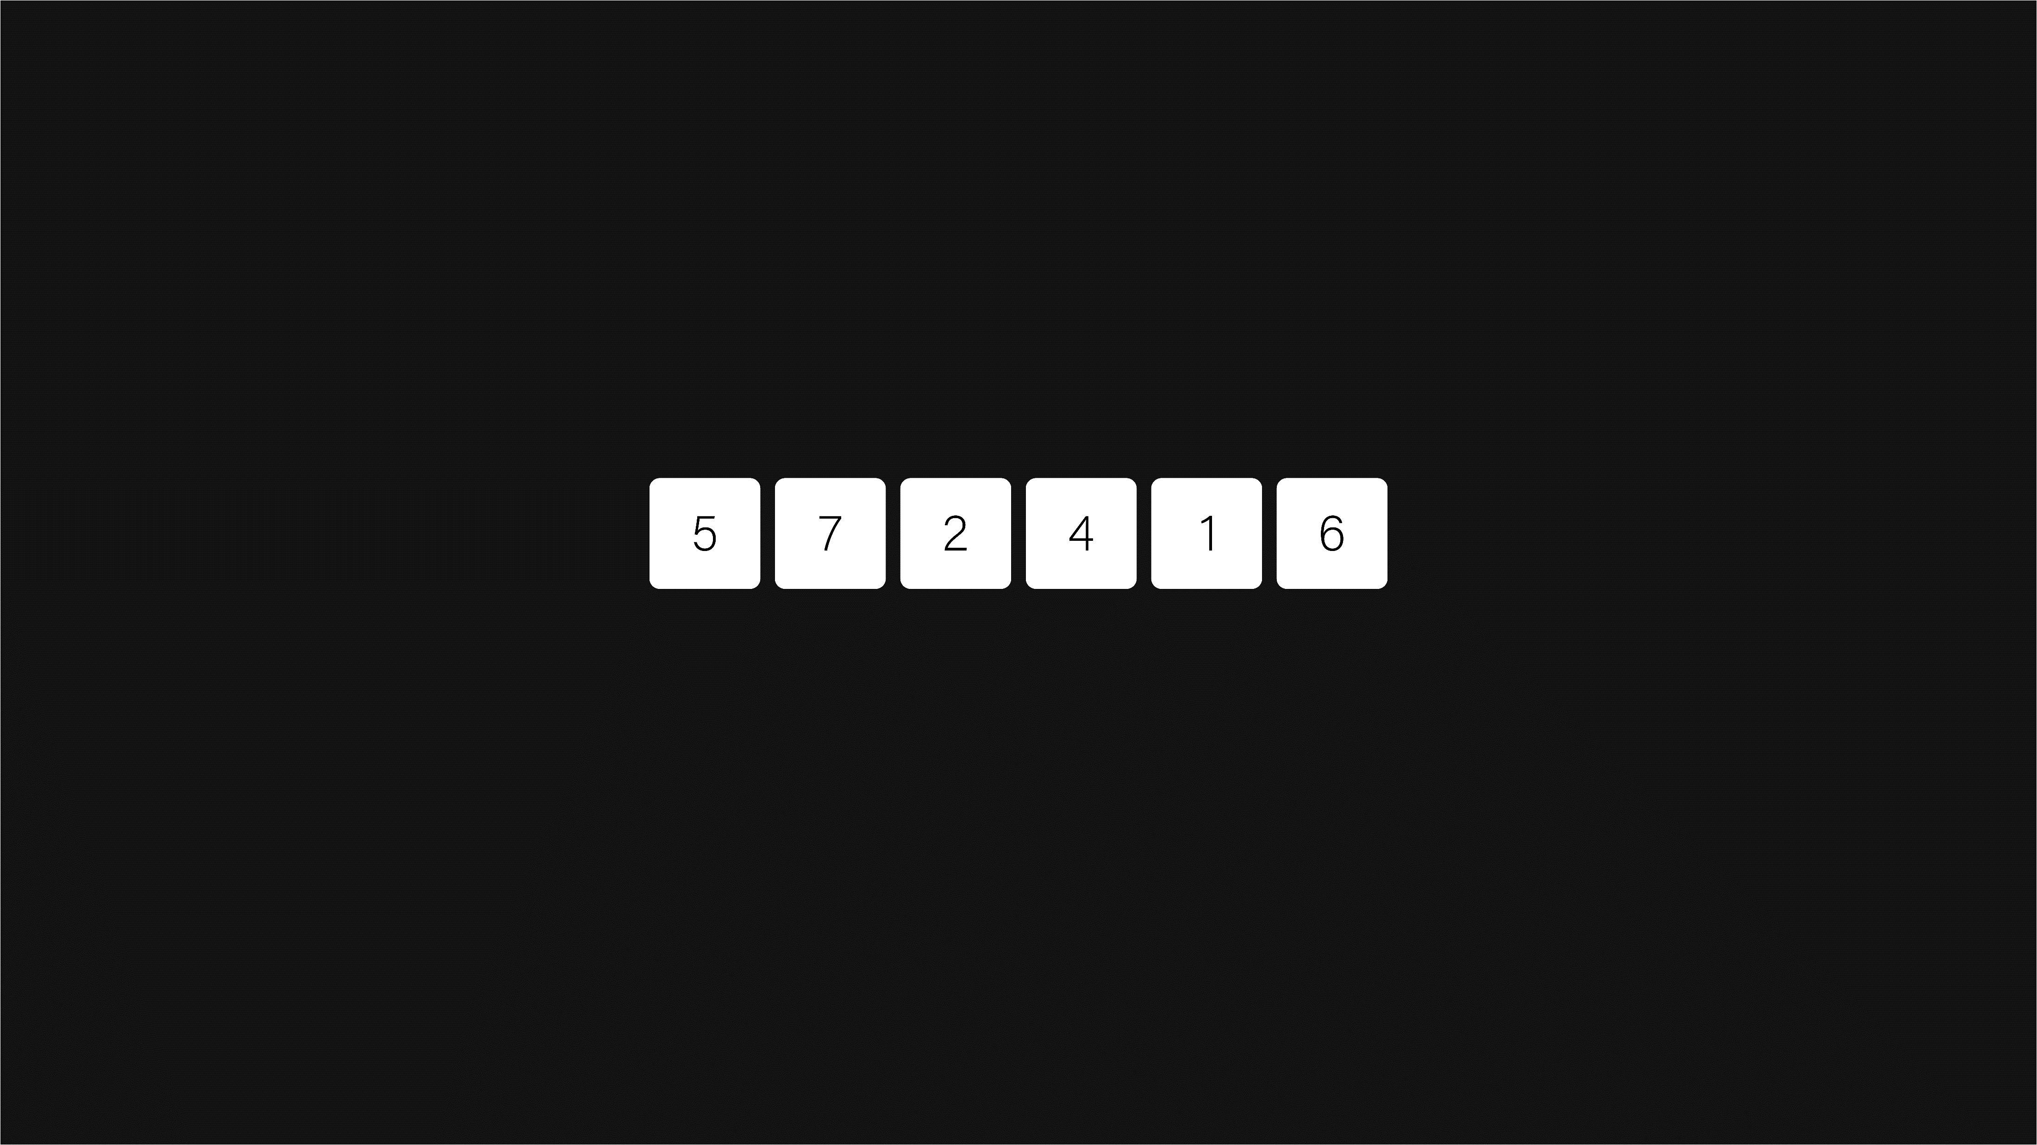
bubble sort
Bubble Sort Algorithm
hconyejelem@uh.edu
casauce3@cougarnet.uh.edu

Slide 9
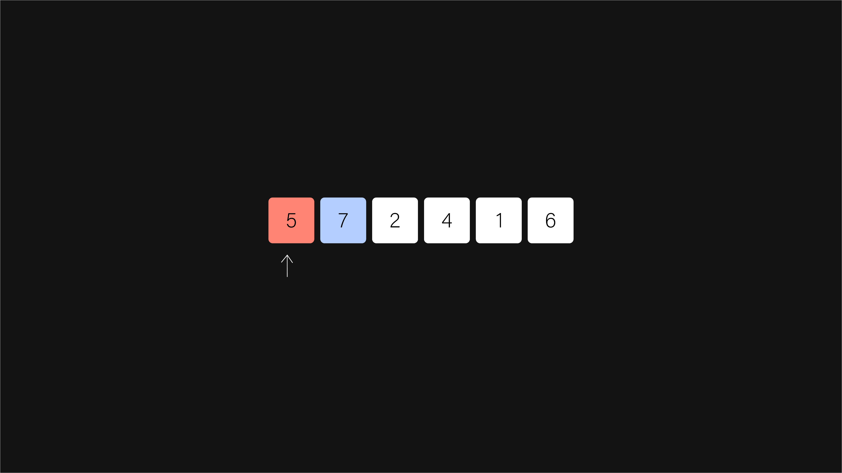
bubble sort
Bubble Sort Algorithm
hconyejelem@uh.edu
casauce3@cougarnet.uh.edu

Slide 10
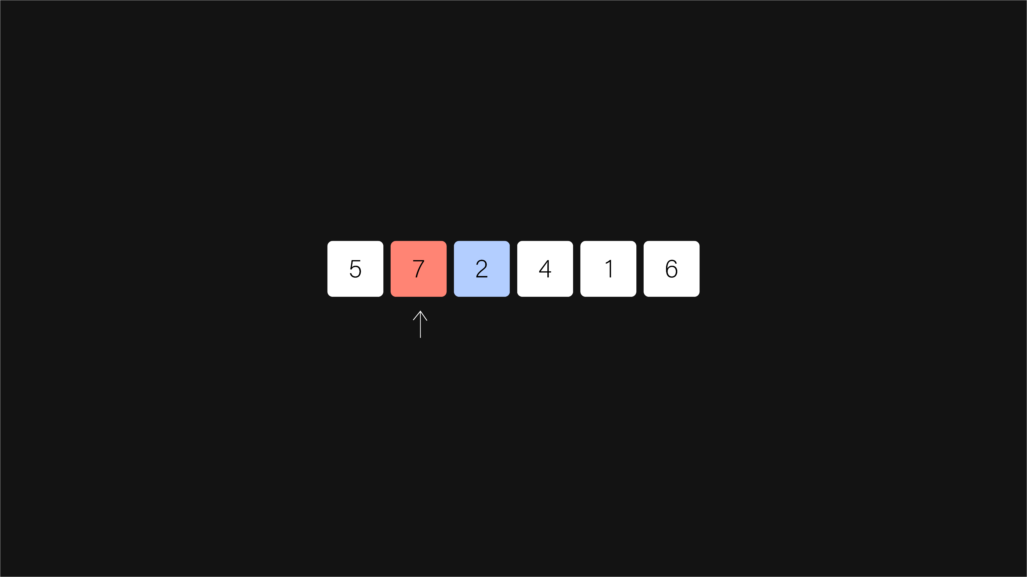
bubble sort
Bubble Sort Algorithm
hconyejelem@uh.edu
casauce3@cougarnet.uh.edu

Slide 11
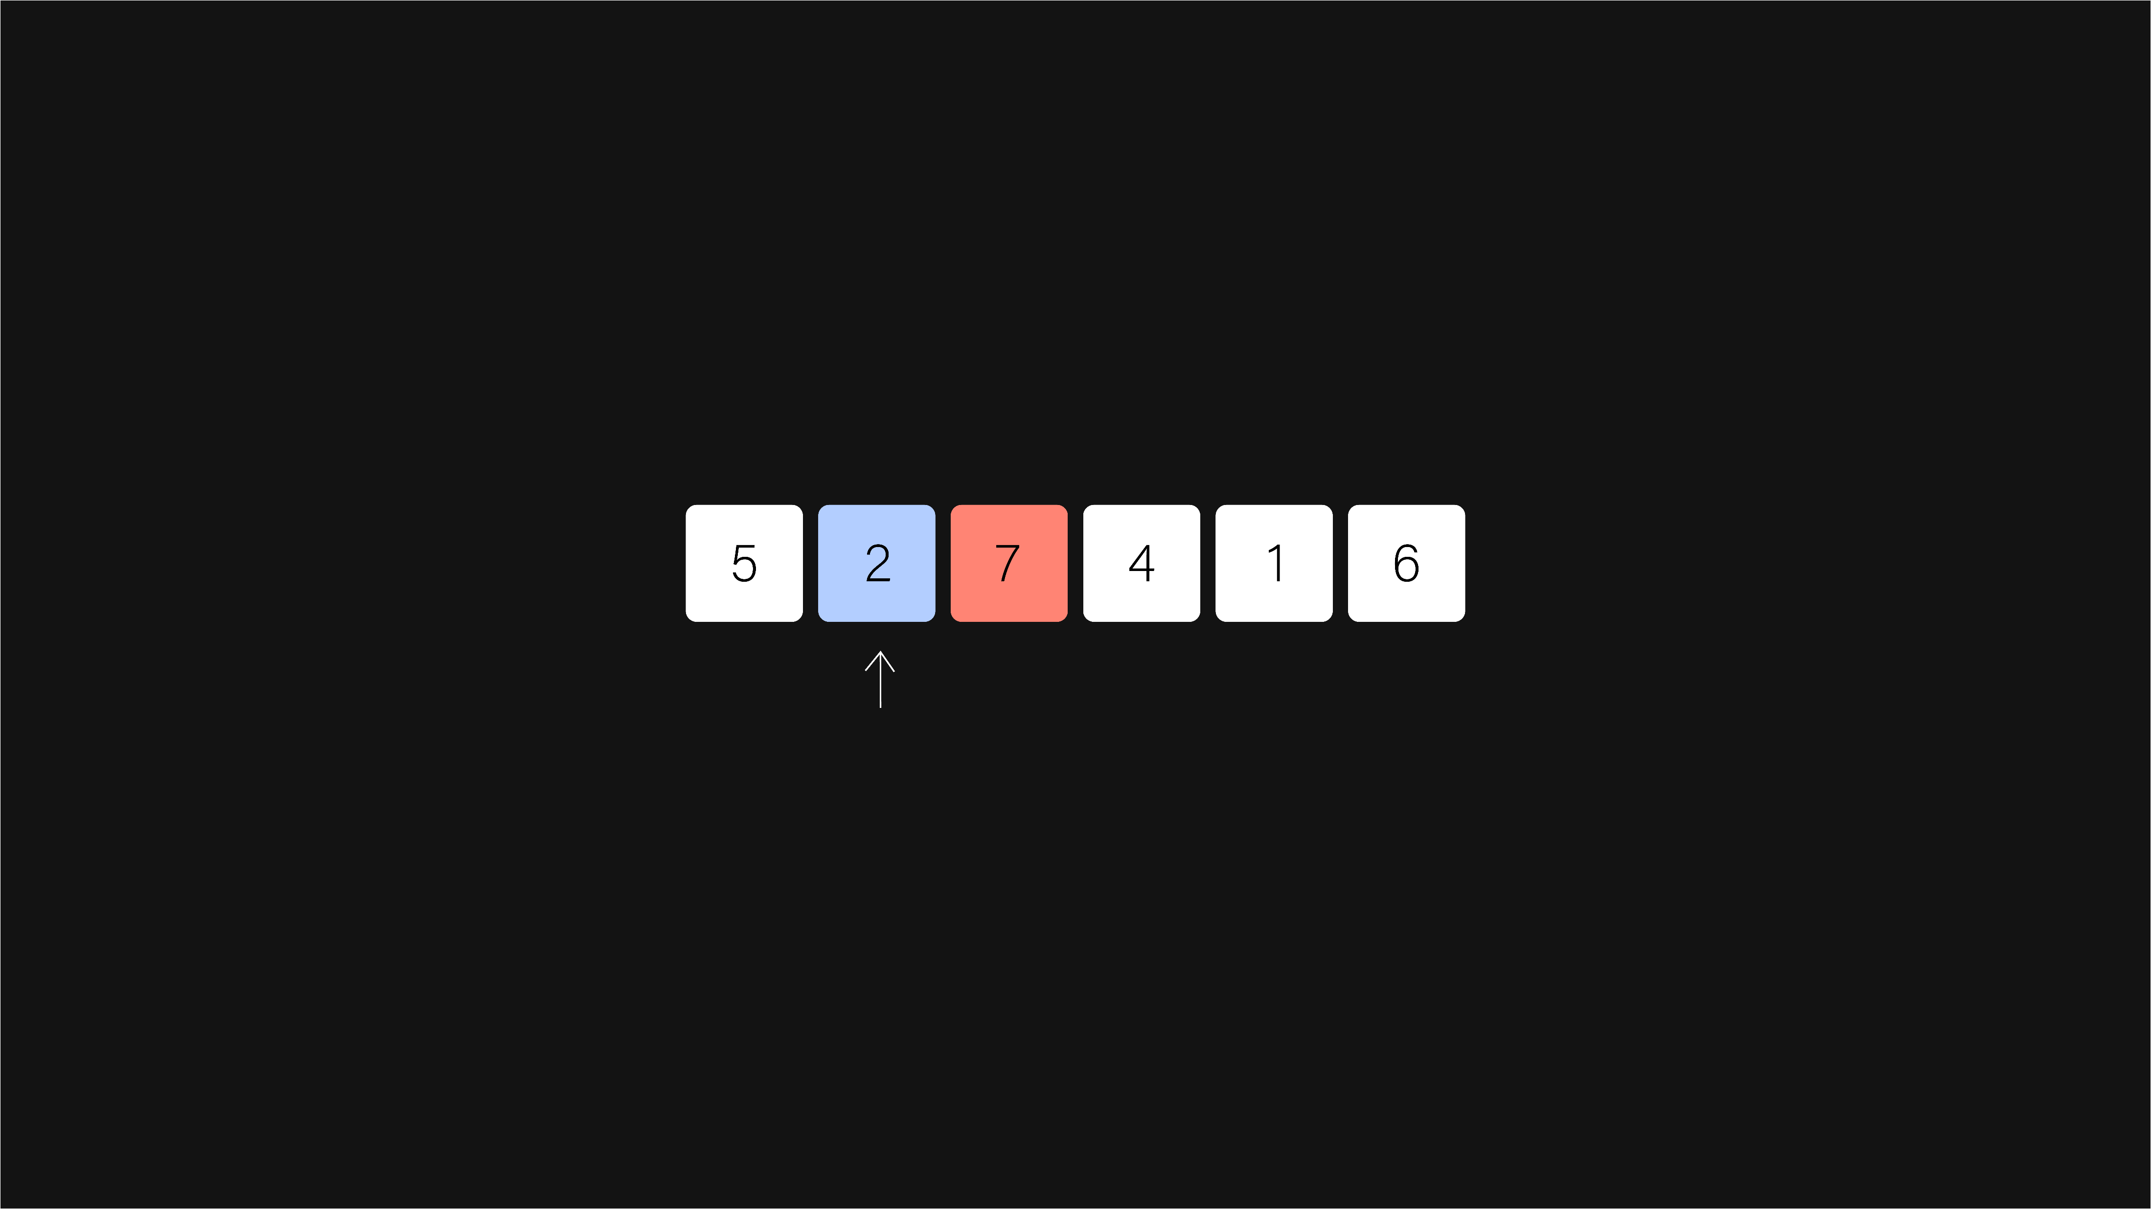
bubble sort
Bubble Sort Algorithm
hconyejelem@uh.edu
casauce3@cougarnet.uh.edu

Slide 12
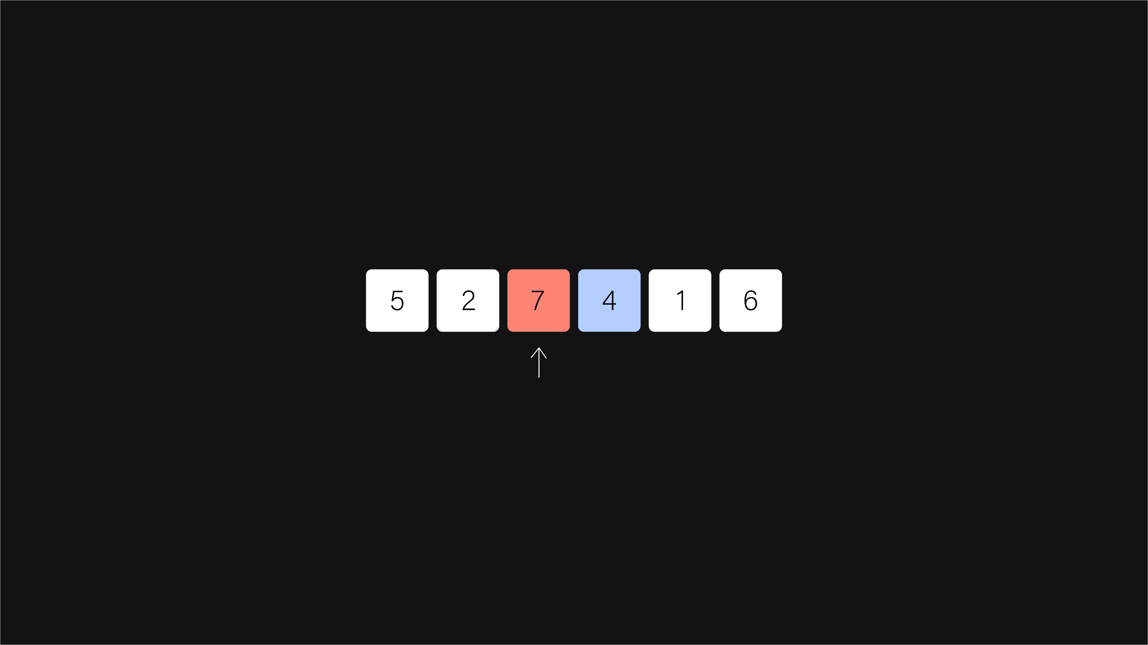
bubble sort
Bubble Sort Algorithm
hconyejelem@uh.edu
casauce3@cougarnet.uh.edu

Slide 13
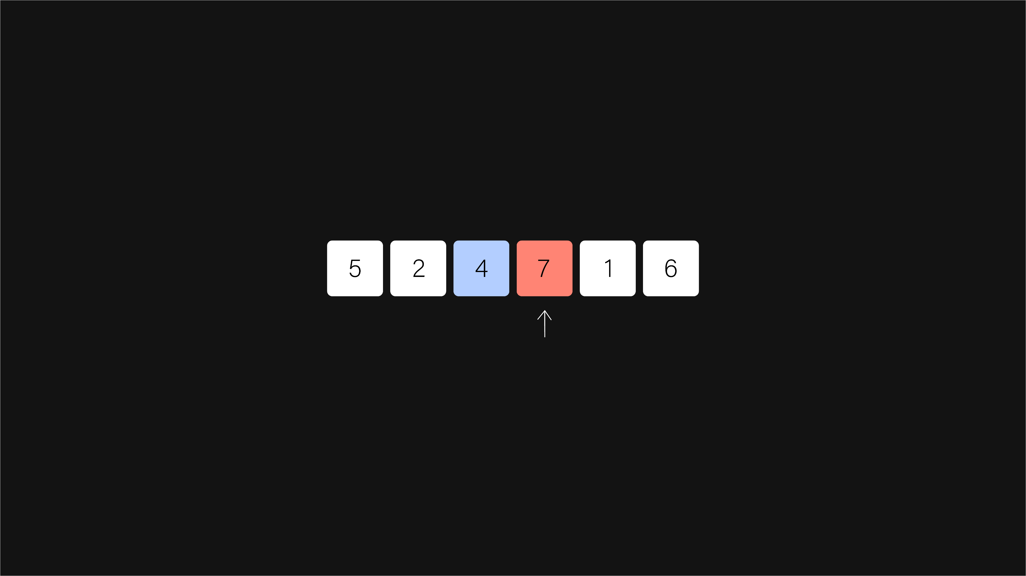
bubble sort
Bubble Sort Algorithm
hconyejelem@uh.edu
casauce3@cougarnet.uh.edu

Slide 14
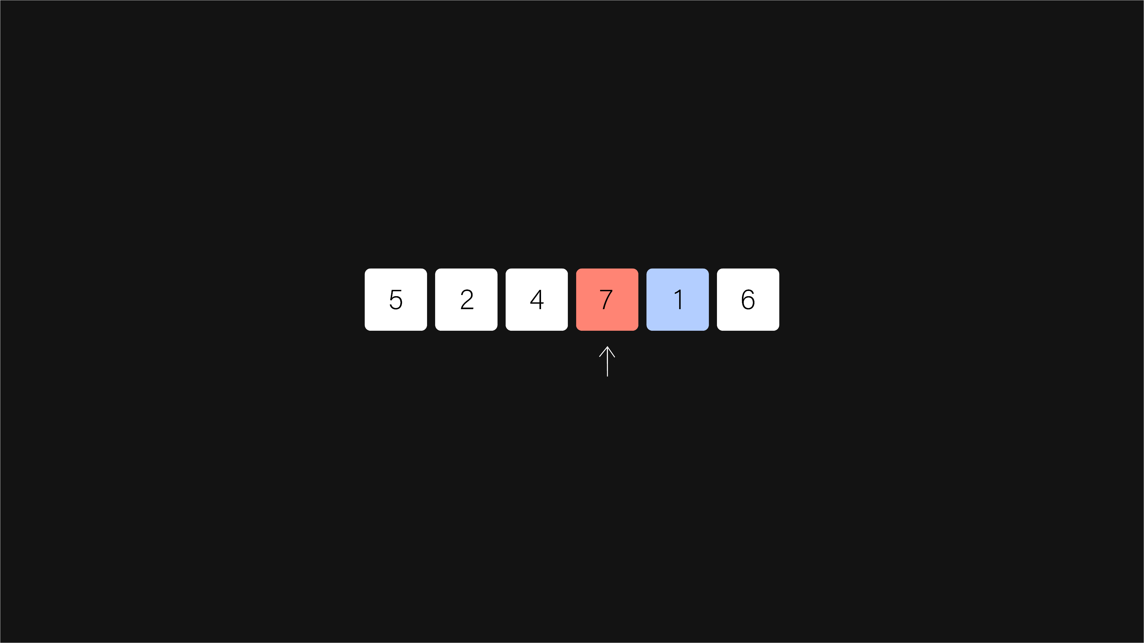
bubble sort
Bubble Sort Algorithm
hconyejelem@uh.edu
casauce3@cougarnet.uh.edu

Slide 15
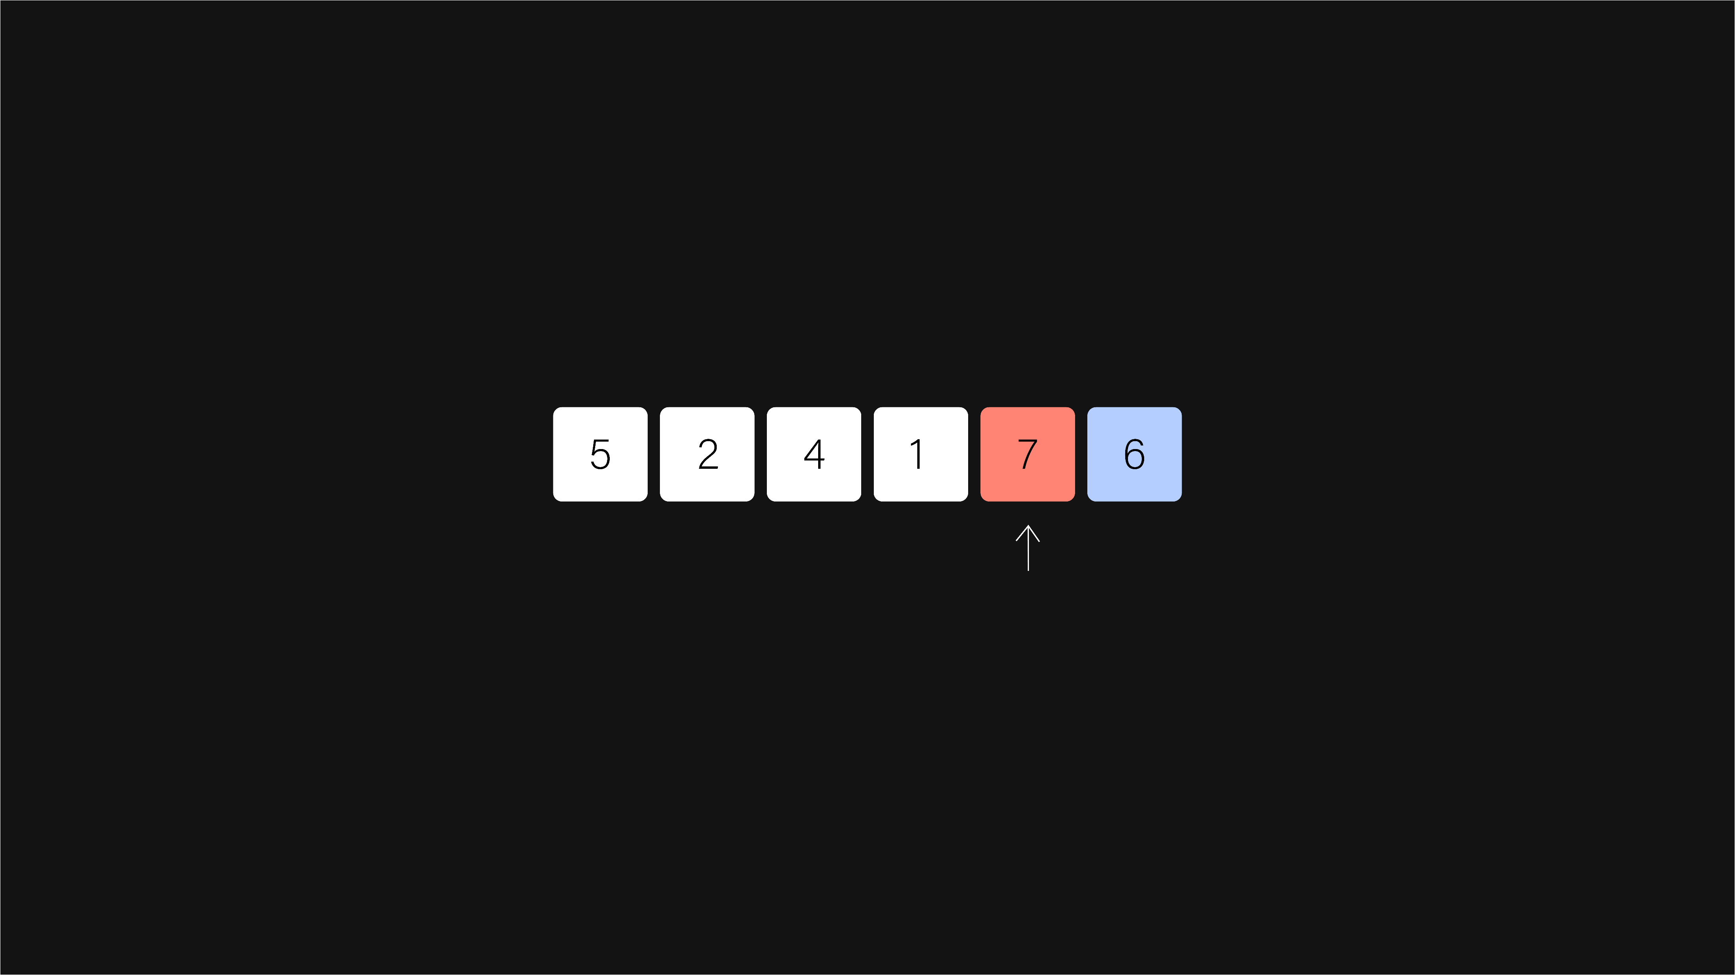
bubble sort
Bubble Sort Algorithm
hconyejelem@uh.edu
casauce3@cougarnet.uh.edu

Slide 16
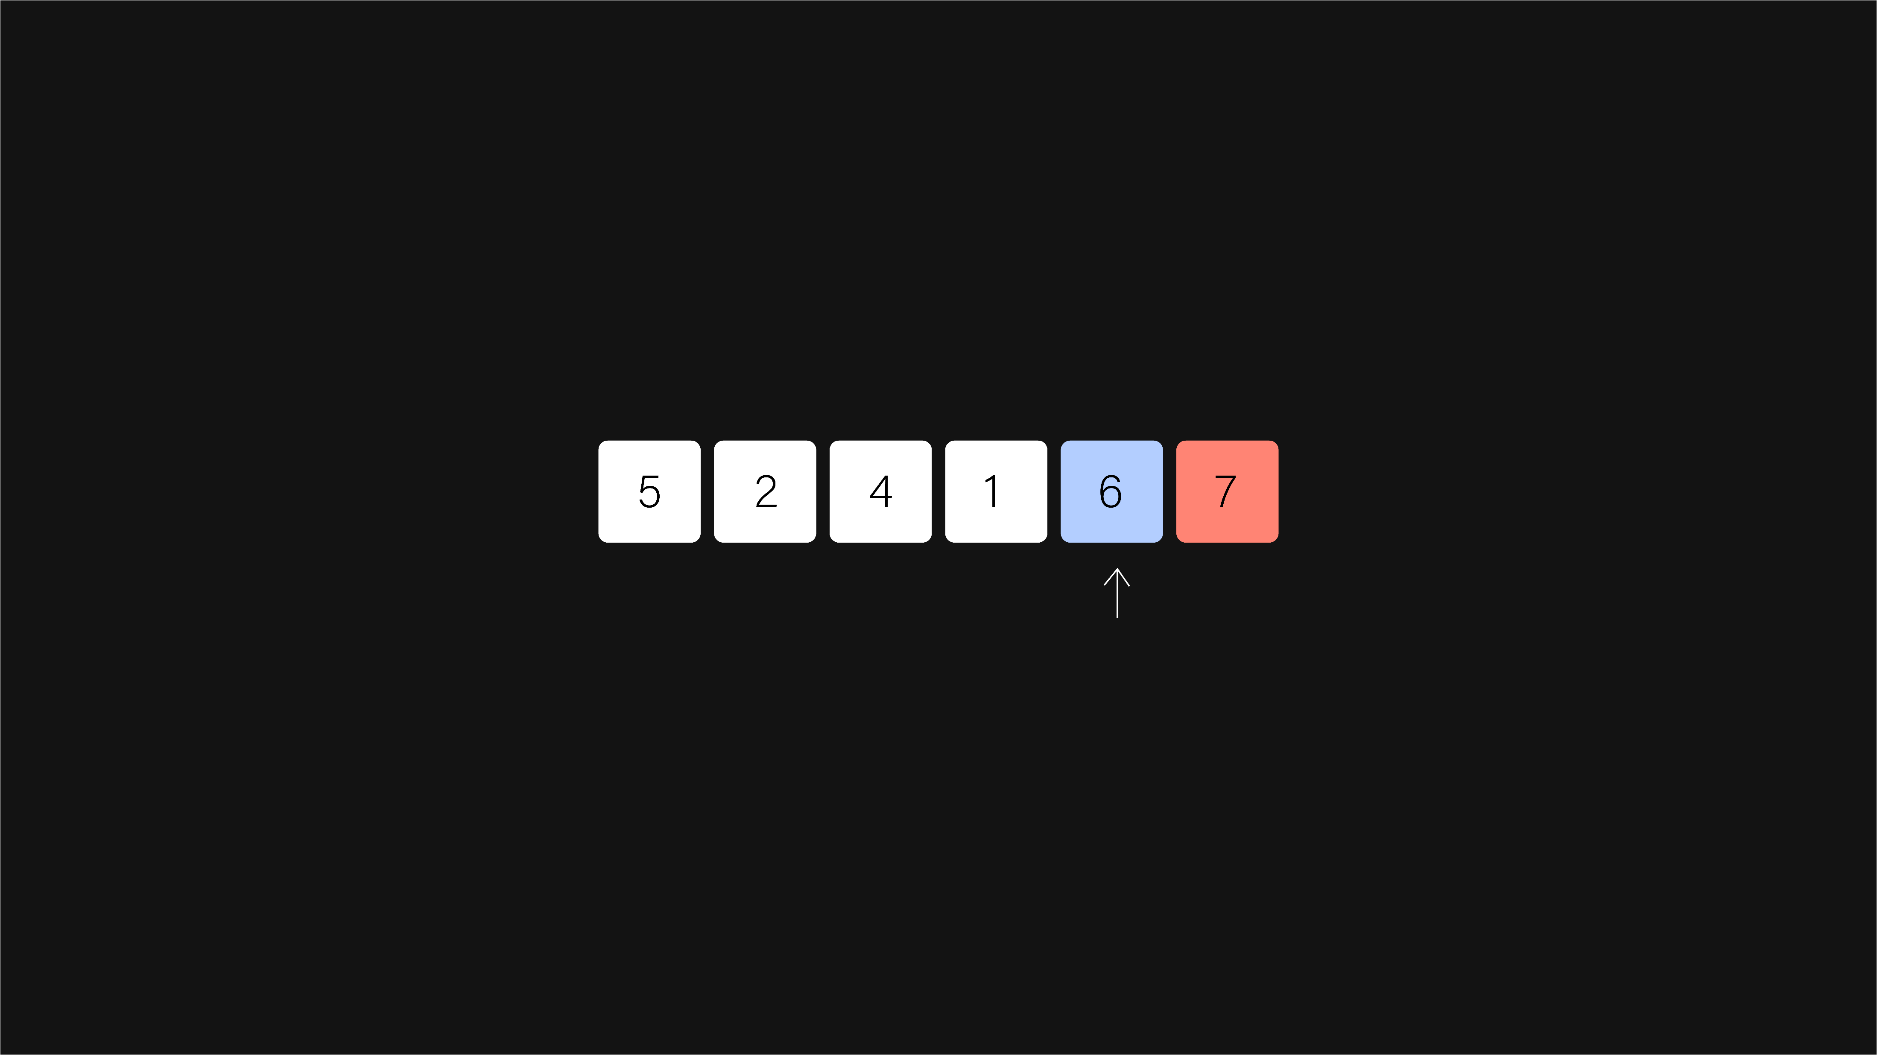
bubble sort
Bubble Sort Algorithm
hconyejelem@uh.edu
casauce3@cougarnet.uh.edu

Slide 17
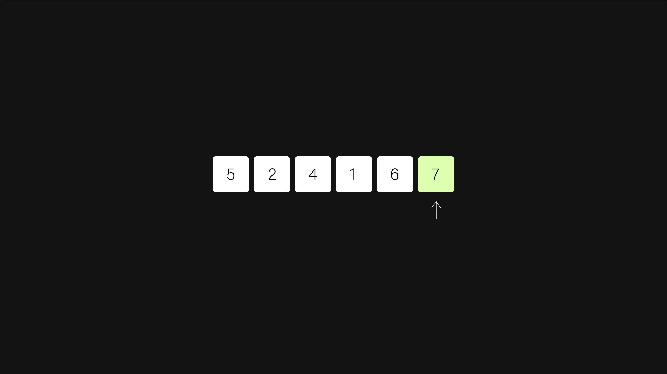
bubble sort
Bubble Sort Algorithm
hconyejelem@uh.edu
casauce3@cougarnet.uh.edu

Slide 18
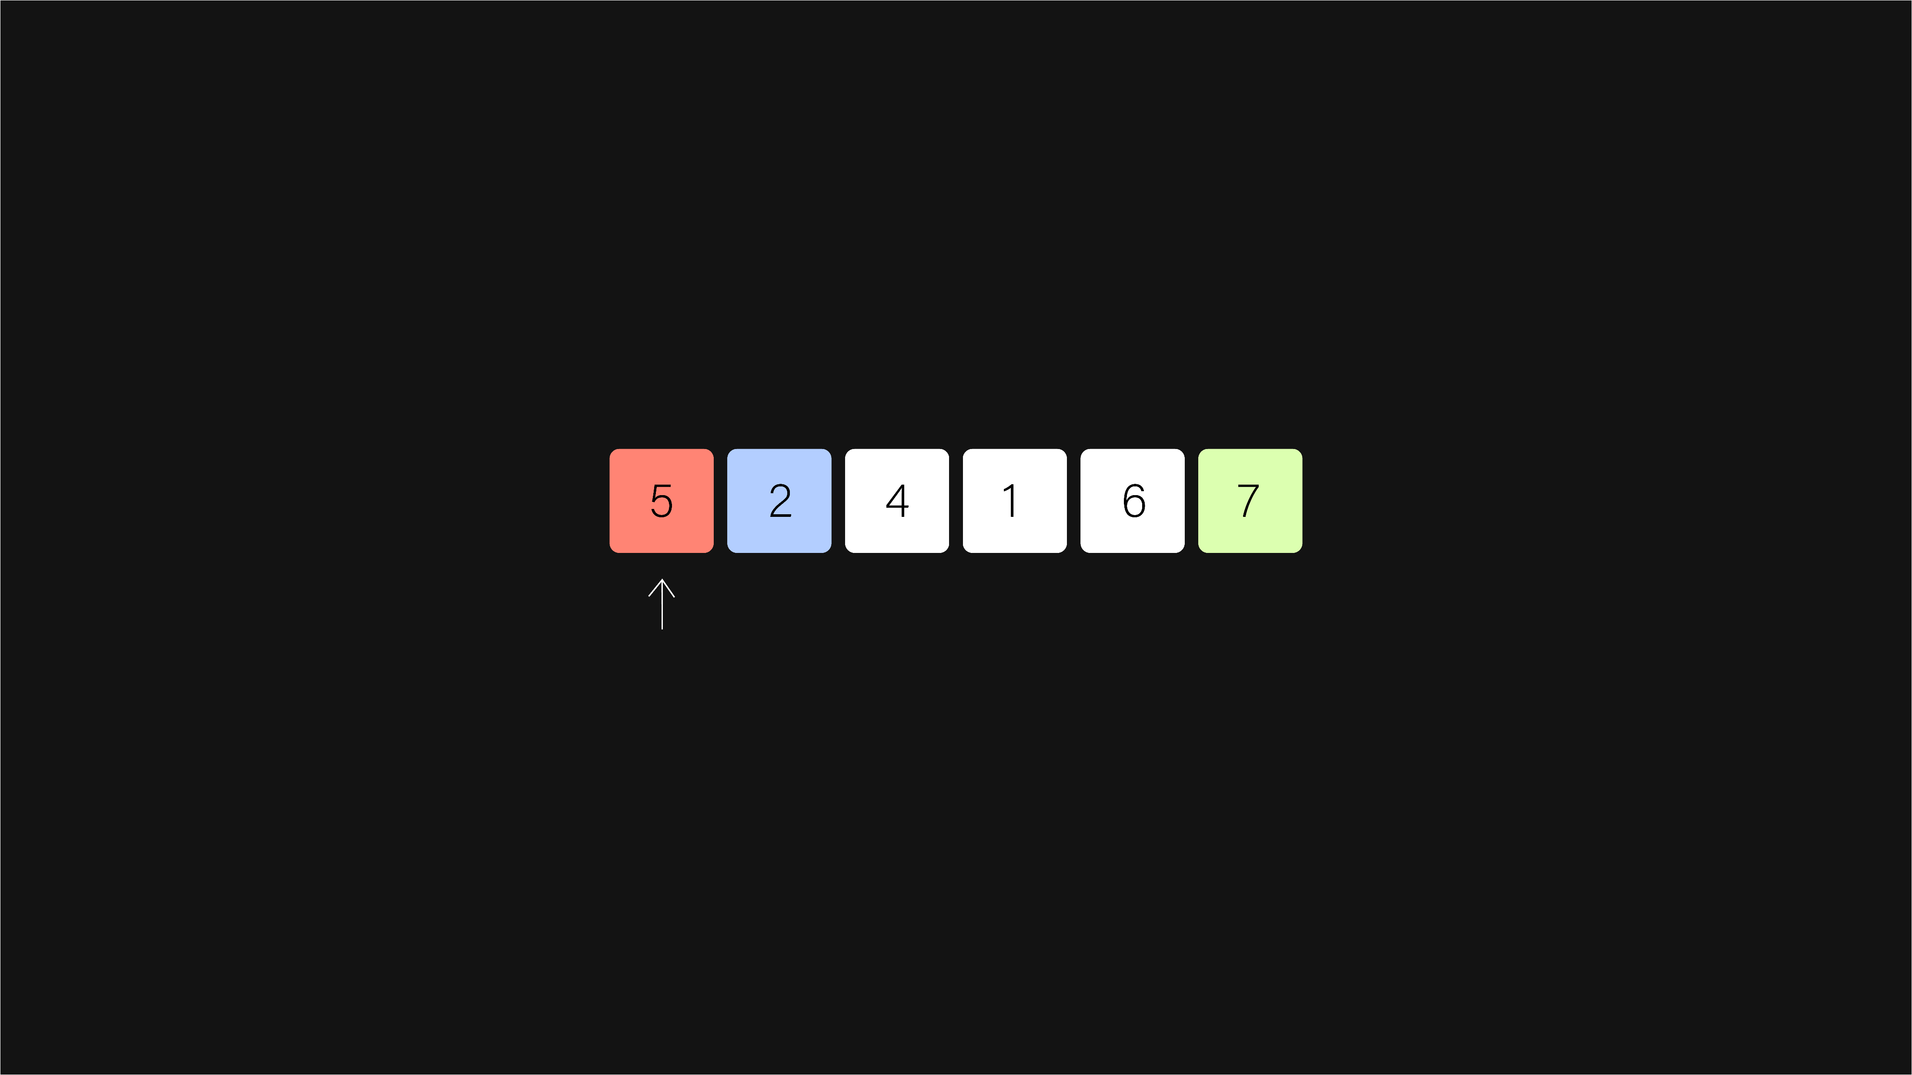
bubble sort
Bubble Sort Algorithm
hconyejelem@uh.edu
casauce3@cougarnet.uh.edu

Slide 19

bubble sort
Bubble Sort Algorithm
hconyejelem@uh.edu
casauce3@cougarnet.uh.edu

Slide 20

bubble sort
Bubble Sort Algorithm
hconyejelem@uh.edu
casauce3@cougarnet.uh.edu

Slide 21

bubble sort
Bubble Sort Algorithm
hconyejelem@uh.edu
casauce3@cougarnet.uh.edu

Slide 22
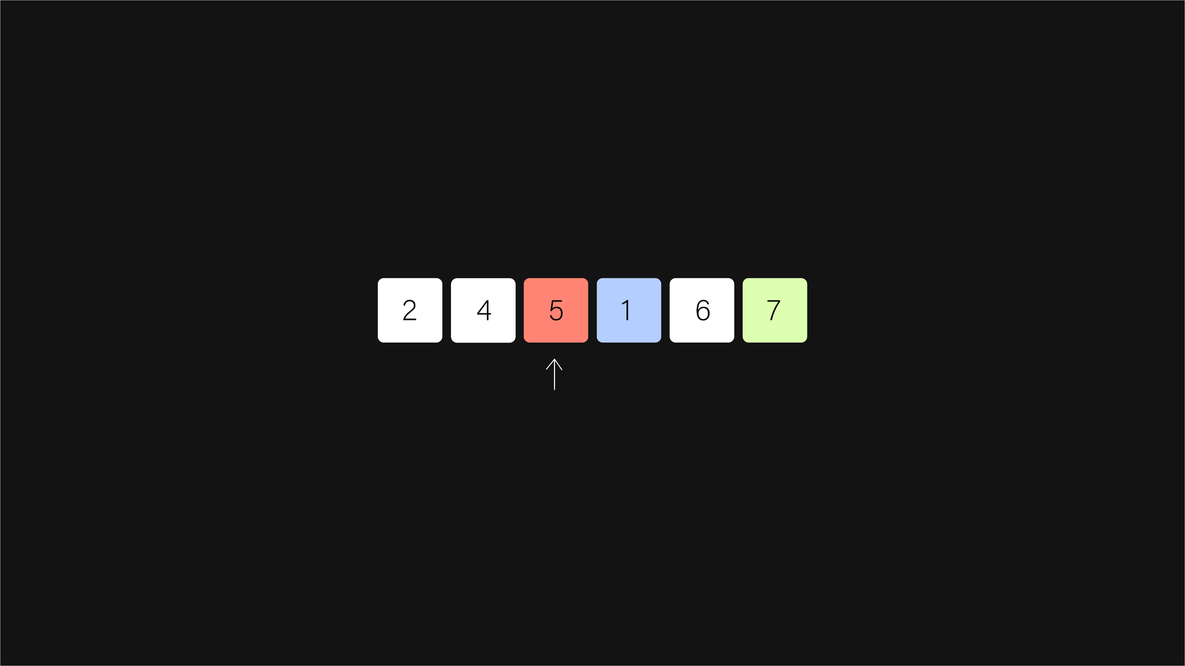
bubble sort
Bubble Sort Algorithm
hconyejelem@uh.edu
casauce3@cougarnet.uh.edu

Slide 23
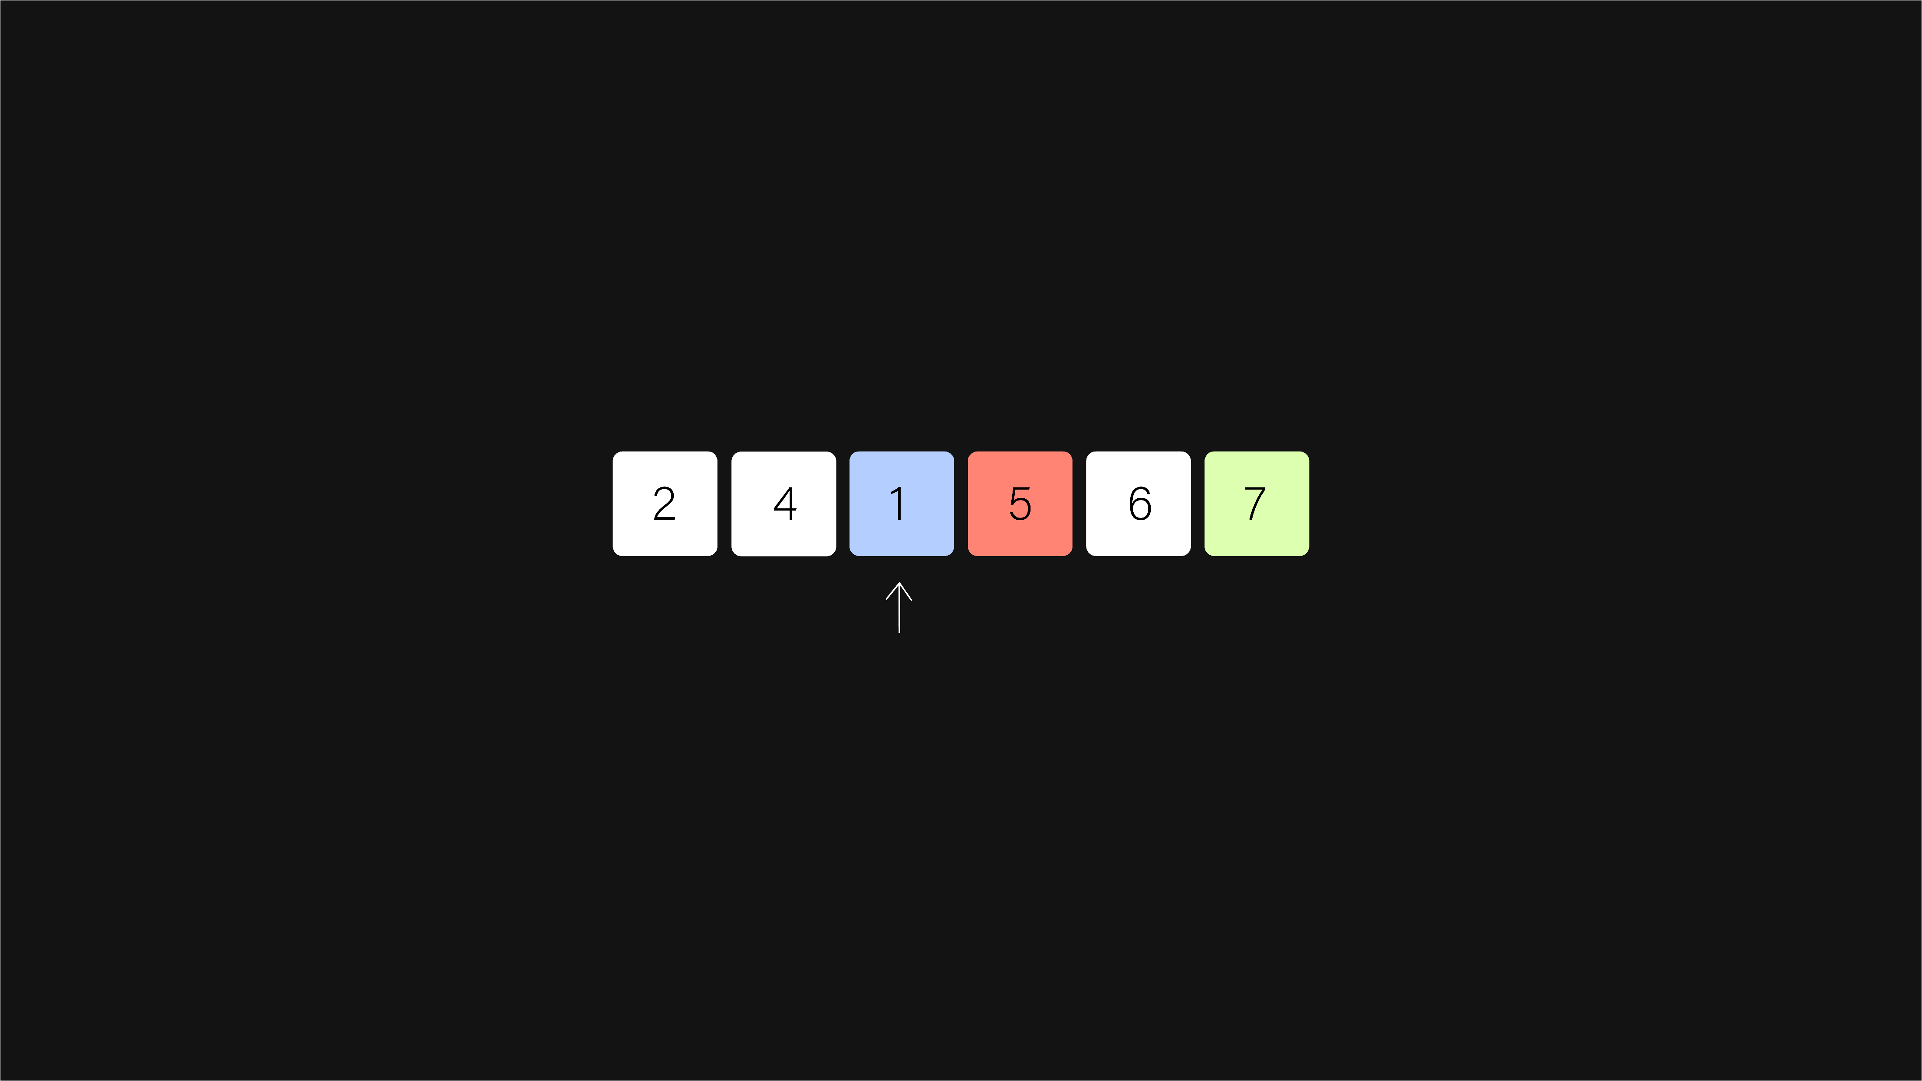
bubble sort
Bubble Sort Algorithm
hconyejelem@uh.edu
casauce3@cougarnet.uh.edu

Slide 24
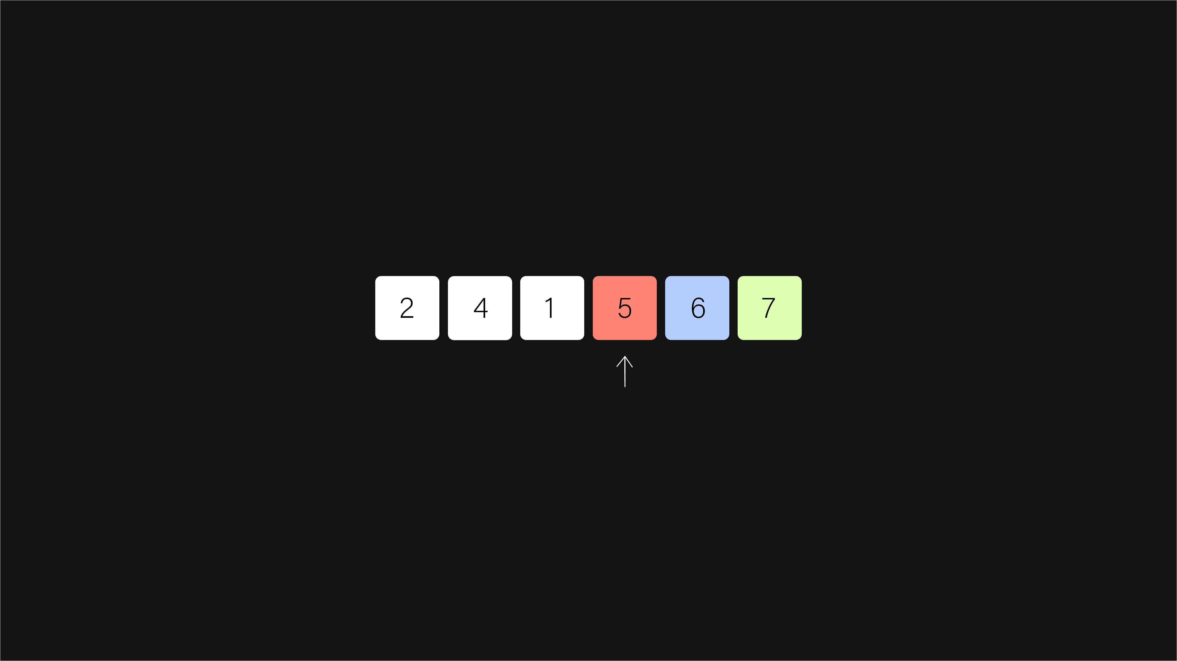
bubble sort
Bubble Sort Algorithm
hconyejelem@uh.edu
casauce3@cougarnet.uh.edu

Slide 25
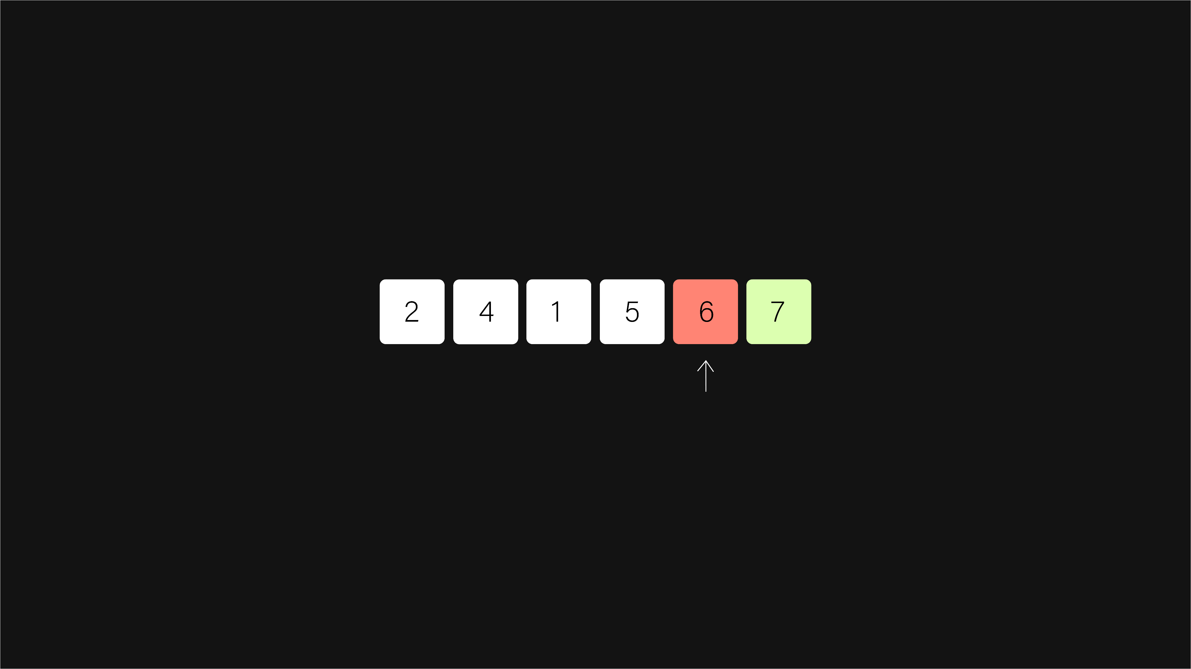
bubble sort
Bubble Sort Algorithm
hconyejelem@uh.edu
casauce3@cougarnet.uh.edu

Slide 26
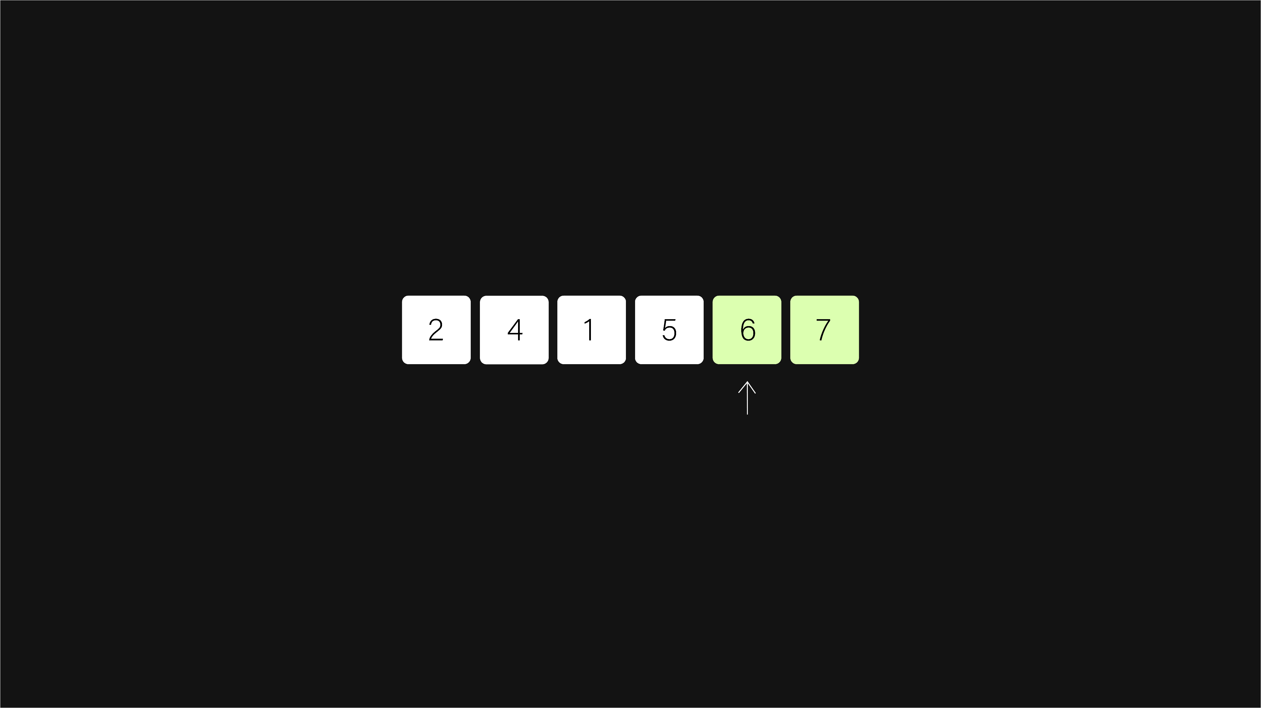
bubble sort
Bubble Sort Algorithm
hconyejelem@uh.edu
casauce3@cougarnet.uh.edu

Slide 27

bubble sort
Bubble Sort Algorithm
hconyejelem@uh.edu
casauce3@cougarnet.uh.edu

Slide 28
bubble sort
Bubble Sort Algorithm
hconyejelem@uh.edu
casauce3@cougarnet.uh.edu

Slide 29

bubble sort
Bubble Sort Algorithm
hconyejelem@uh.edu
casauce3@cougarnet.uh.edu

Slide 30

bubble sort
Bubble Sort Algorithm
hconyejelem@uh.edu
casauce3@cougarnet.uh.edu

Slide 31
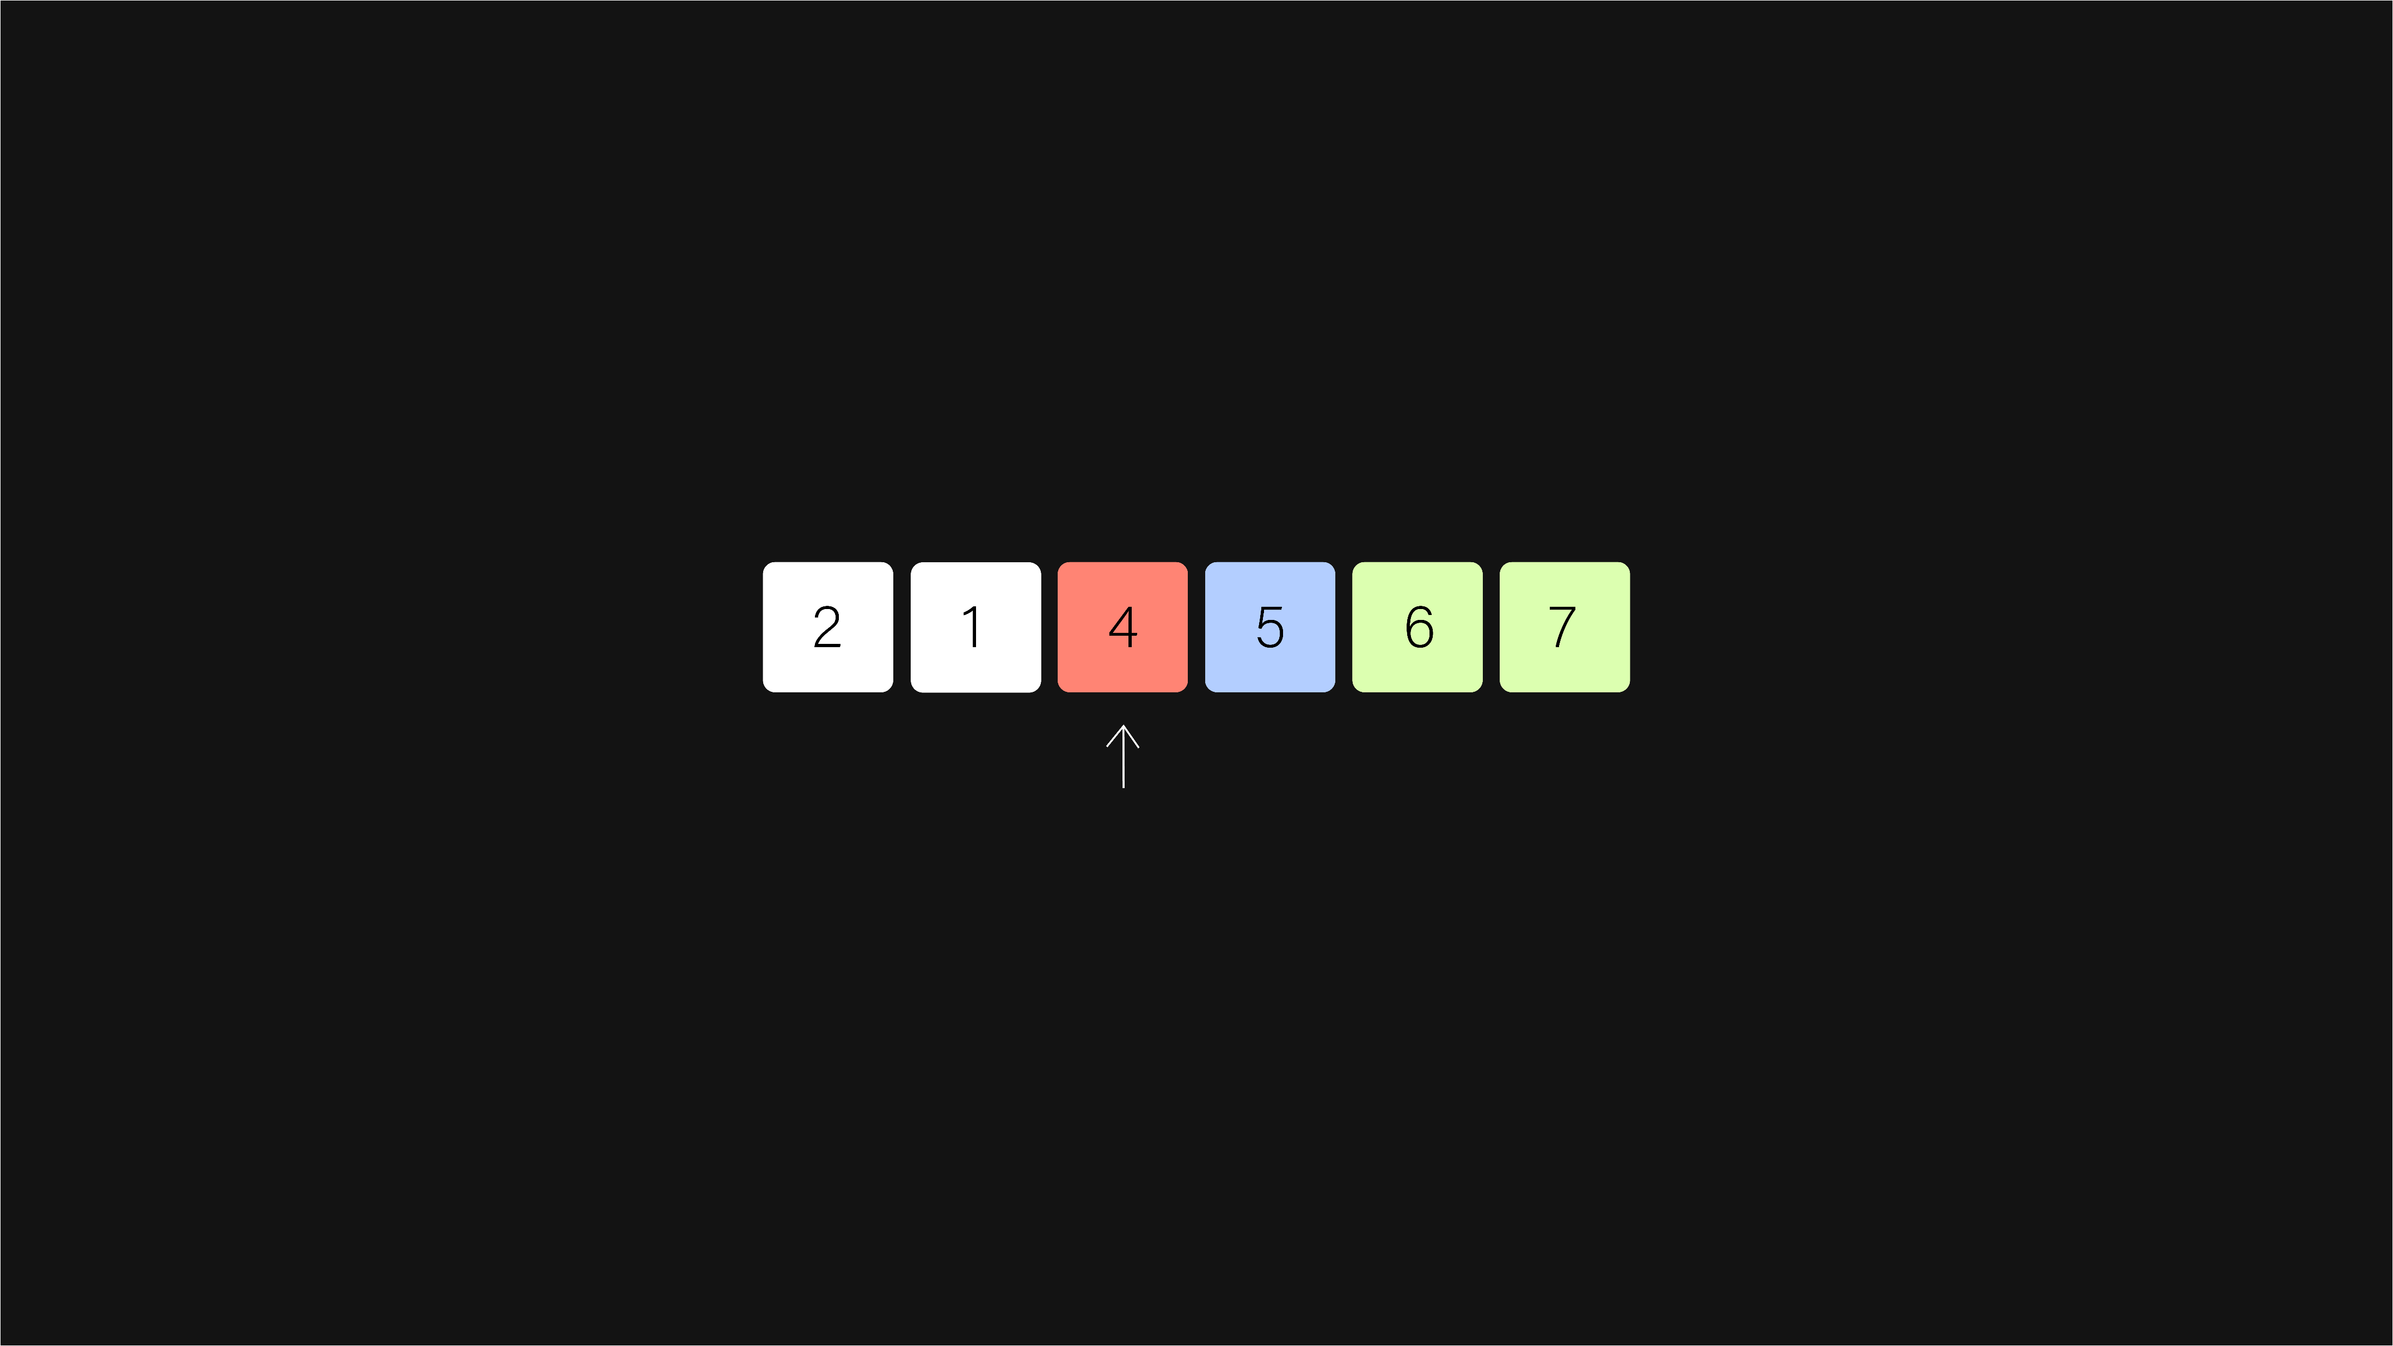
bubble sort
Bubble Sort Algorithm
hconyejelem@uh.edu
casauce3@cougarnet.uh.edu

Slide 32

bubble sort
Bubble Sort Algorithm
hconyejelem@uh.edu
casauce3@cougarnet.uh.edu

Slide 33

bubble sort
Bubble Sort Algorithm
hconyejelem@uh.edu
casauce3@cougarnet.uh.edu

Slide 34
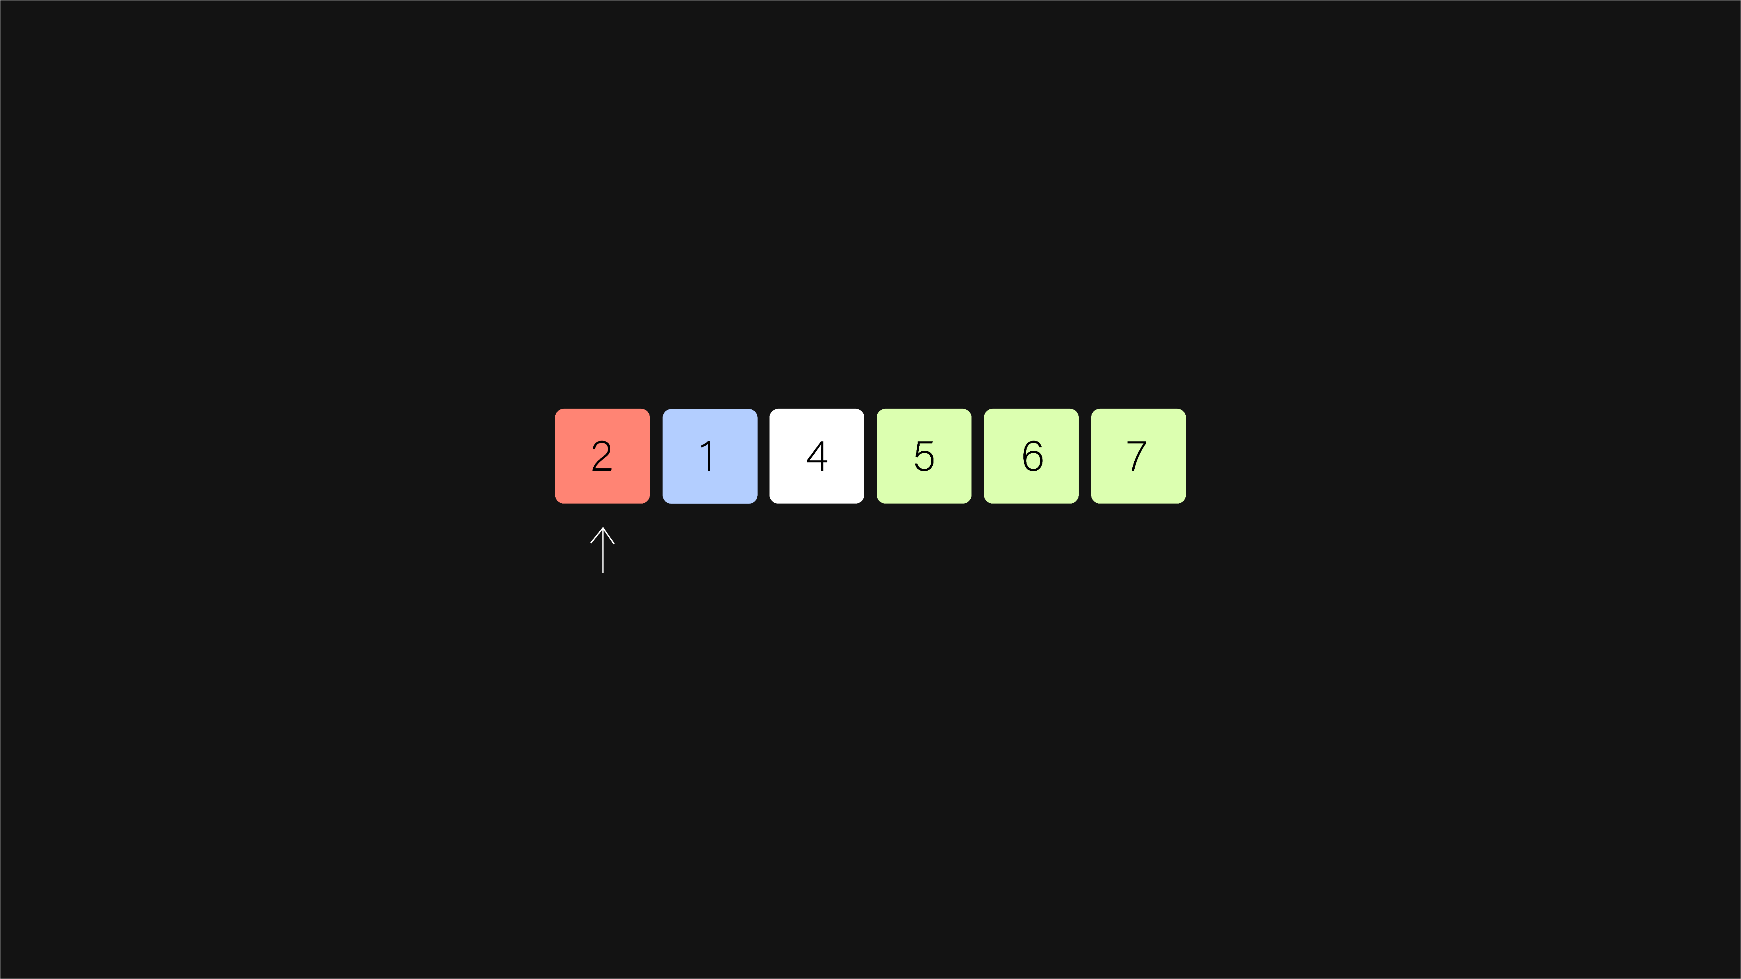
bubble sort
Bubble Sort Algorithm
hconyejelem@uh.edu
casauce3@cougarnet.uh.edu

Slide 35

bubble sort
Bubble Sort Algorithm
hconyejelem@uh.edu
casauce3@cougarnet.uh.edu

Slide 36

bubble sort
Bubble Sort Algorithm
hconyejelem@uh.edu
casauce3@cougarnet.uh.edu

Slide 37
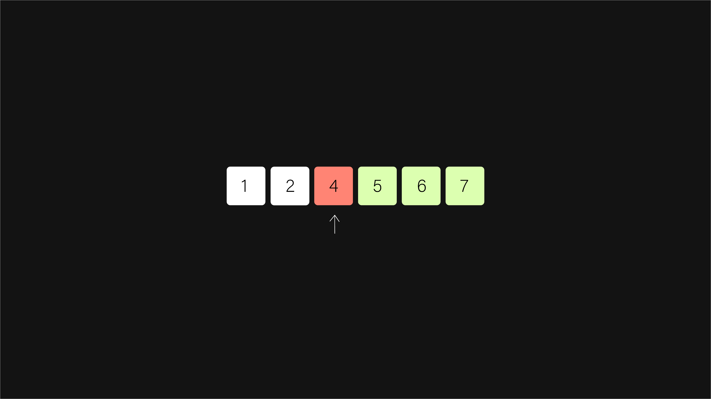
bubble sort
Bubble Sort Algorithm
hconyejelem@uh.edu
casauce3@cougarnet.uh.edu

Slide 38

bubble sort
Bubble Sort Algorithm
hconyejelem@uh.edu
casauce3@cougarnet.uh.edu

Slide 39
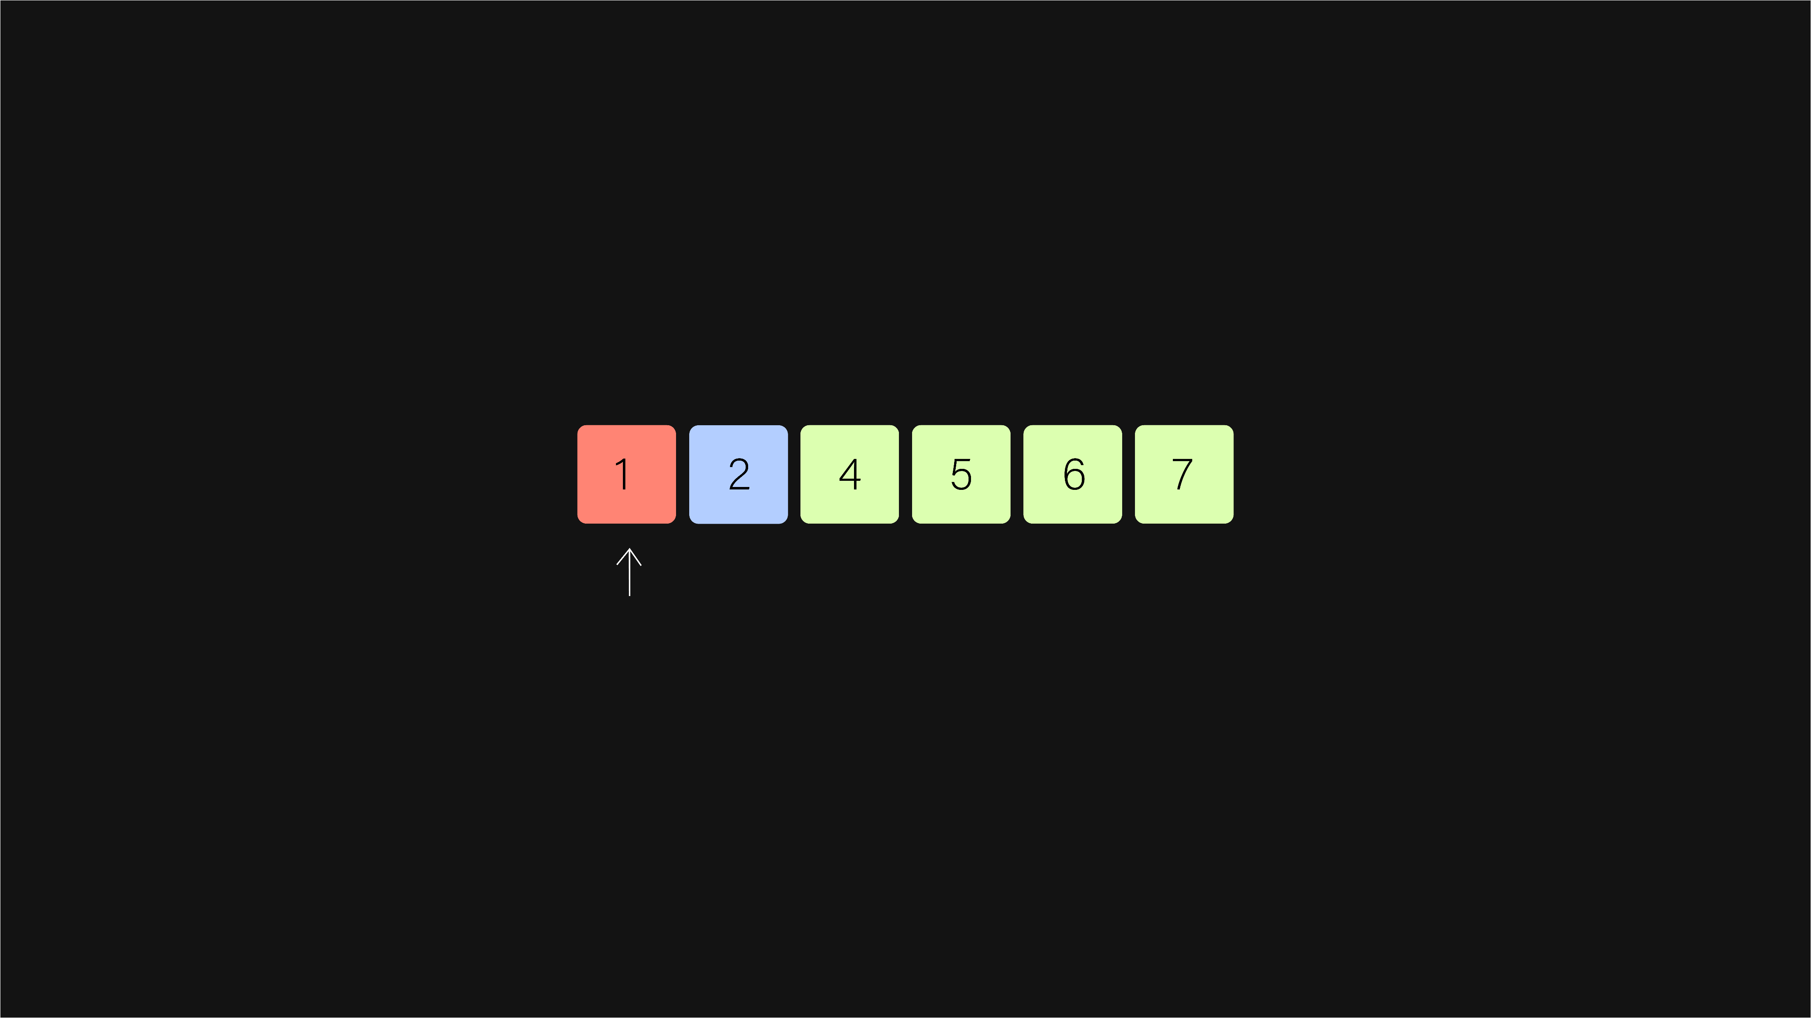
bubble sort
Bubble Sort Algorithm
hconyejelem@uh.edu
casauce3@cougarnet.uh.edu

Slide 40

bubble sort
Bubble Sort Algorithm
hconyejelem@uh.edu
casauce3@cougarnet.uh.edu

Slide 41
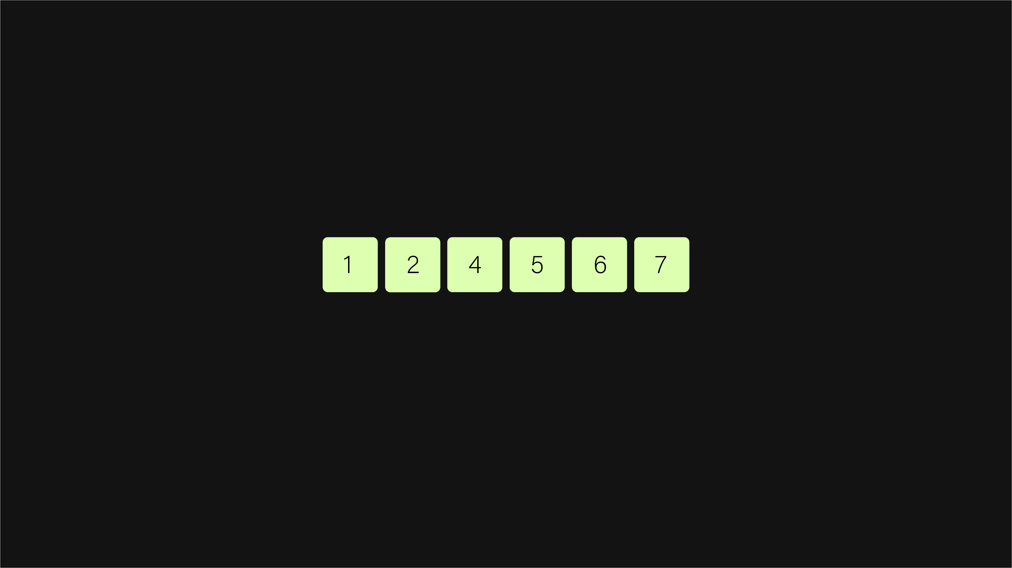
bubble sort
Bubble Sort Algorithm
hconyejelem@uh.edu
casauce3@cougarnet.uh.edu

Slide 42
bubble sort
Code:
void bubbleSort(int arr[], int n)
{
bool swapped;
for (i = 0; i < n - 1; i++) {
swapped = false;
for (j = 0; j < n - i - 1; j++) {
if (arr[j] > arr[j + 1]) {
swap(&arr[j], &arr[j + 1]);
swapped = true;
}
}
if (swapped == false)
break;
}
}
hconyejelem@uh.edu
casauce3@cougarnet.uh.edu

Slide 43
bubble sort
Time Complexity:
Bubble Sort's time complexity is its primary drawback. In the worst-case scenario, where the input array is sorted in reverse order, Bubble Sort exhibits a time complexity of O(n^2), where 'n' represents the number of elements in the array. This quadratic time complexity means that the algorithm's execution time grows quadratically with the size of the input.
However, in the best-case scenario (when the array is already sorted), Bubble Sort performs significantly better with a time complexity of O(n). In practice, though, the worst-case scenario is more relevant, and other sorting algorithms like Quick Sort or Merge Sort are typically preferred for large datasets.
hconyejelem@uh.edu
casauce3@cougarnet.uh.edu

Slide 44
Selection Sort
Selection Sort is a straightforward, in-place comparison-based sorting algorithm that builds the sorted array one element at a time. It works by repeatedly selecting the smallest (or largest) element from the unsorted portion of the array and placing it at the beginning of the sorted portion. The process continues until the entire array is sorted.
hconyejelem@uh.edu
casauce3@cougarnet.uh.edu

Slide 45
selection sort
Algorithmic Approach
Here's a breakdown of the algorithm's core steps:
Begin with the first element of the array. This element is considered part of the sorted sub-array.
Scan through the remaining unsorted elements to find the smallest (or largest, depending on the sorting order) element.
Swap the smallest (or largest) element found in step 2 with the first element in the unsorted sub-array, effectively extending the sorted sub-array by one element.
Repeat steps 2 and 3 for the next unsorted element until the entire array is sorted.
The algorithm completes when the sorted sub-array includes all elements from the original array.
hconyejelem@uh.edu
casauce3@cougarnet.uh.edu

Slide 46
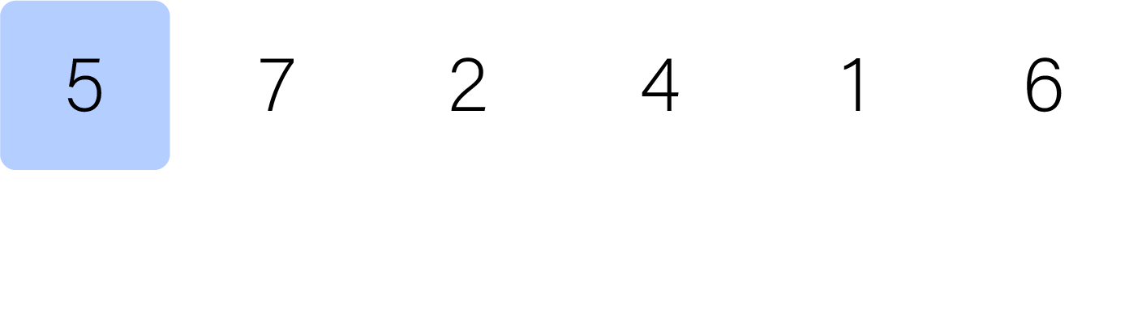
selection sort
Selection Sort Algorithm
hconyejelem@uh.edu
casauce3@cougarnet.uh.edu

Slide 47
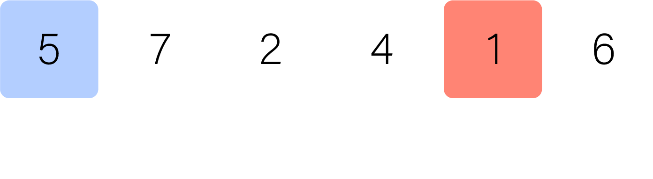
selection sort
Selection Sort Algorithm
hconyejelem@uh.edu
casauce3@cougarnet.uh.edu

Slide 48
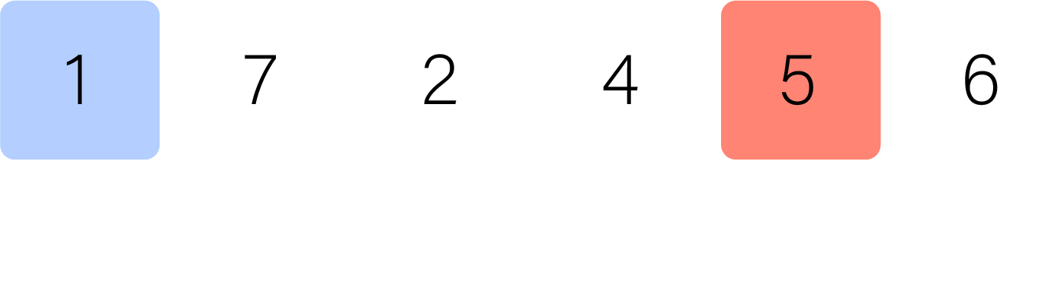
selection sort
Selection Sort Algorithm
hconyejelem@uh.edu
casauce3@cougarnet.uh.edu

Slide 49
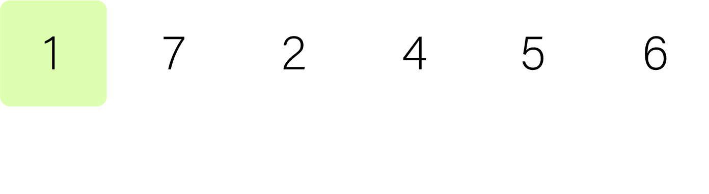
selection sort
Selection Sort Algorithm
hconyejelem@uh.edu
casauce3@cougarnet.uh.edu

Slide 50
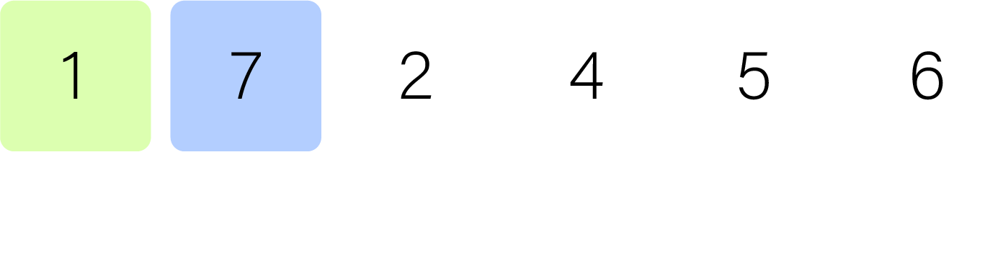
selection sort
Selection Sort Algorithm
hconyejelem@uh.edu
casauce3@cougarnet.uh.edu

Slide 51
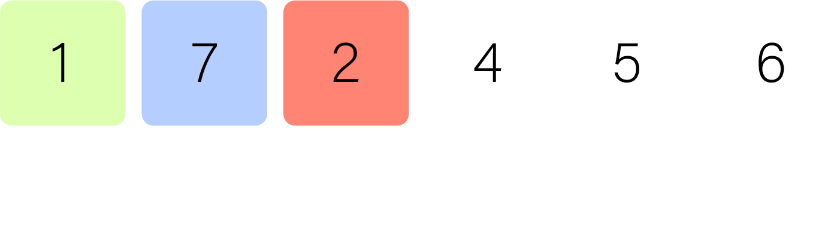
selection sort
Selection Sort Algorithm
hconyejelem@uh.edu
casauce3@cougarnet.uh.edu

Slide 52
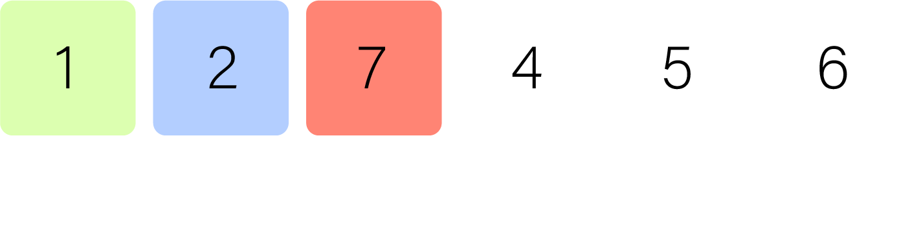
selection sort
Selection Sort Algorithm
hconyejelem@uh.edu
casauce3@cougarnet.uh.edu

Slide 53
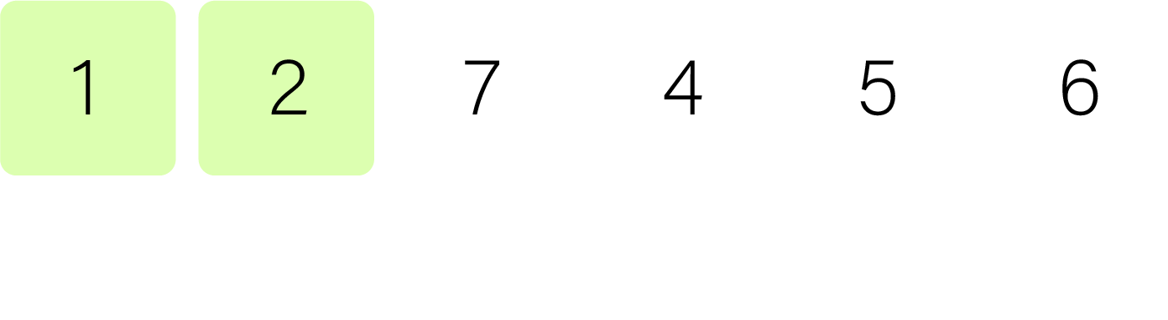
selection sort
Selection Sort Algorithm
hconyejelem@uh.edu
casauce3@cougarnet.uh.edu

Slide 54
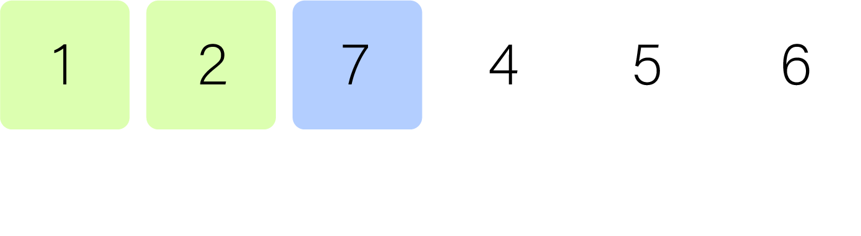
selection sort
Selection Sort Algorithm
hconyejelem@uh.edu
casauce3@cougarnet.uh.edu

Slide 55
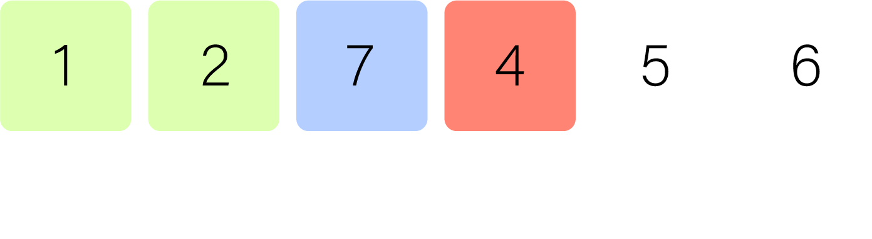
selection sort
Selection Sort Algorithm
hconyejelem@uh.edu
casauce3@cougarnet.uh.edu

Slide 56
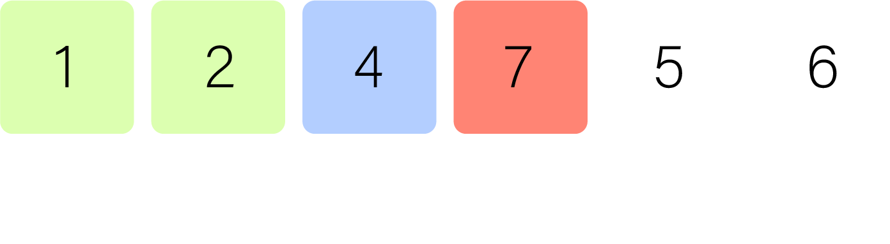
selection sort
Selection Sort Algorithm
hconyejelem@uh.edu
casauce3@cougarnet.uh.edu

Slide 57
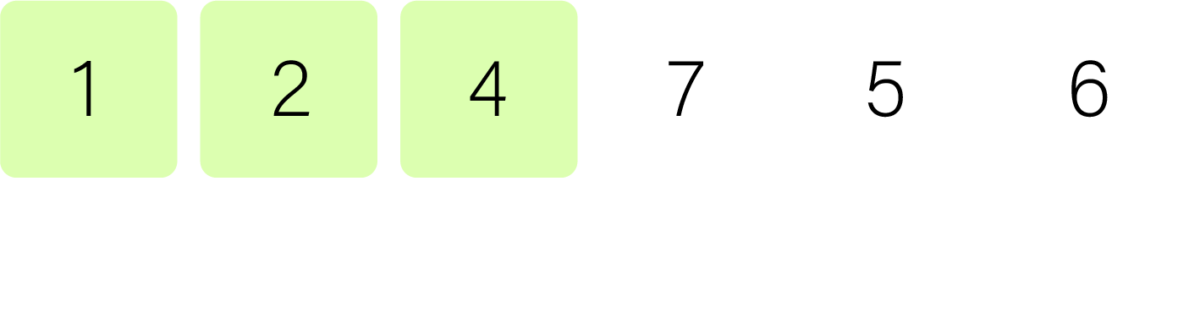
selection sort
Selection Sort Algorithm
hconyejelem@uh.edu
casauce3@cougarnet.uh.edu

Slide 58
selection sort
Selection Sort Algorithm
hconyejelem@uh.edu
casauce3@cougarnet.uh.edu

Slide 59
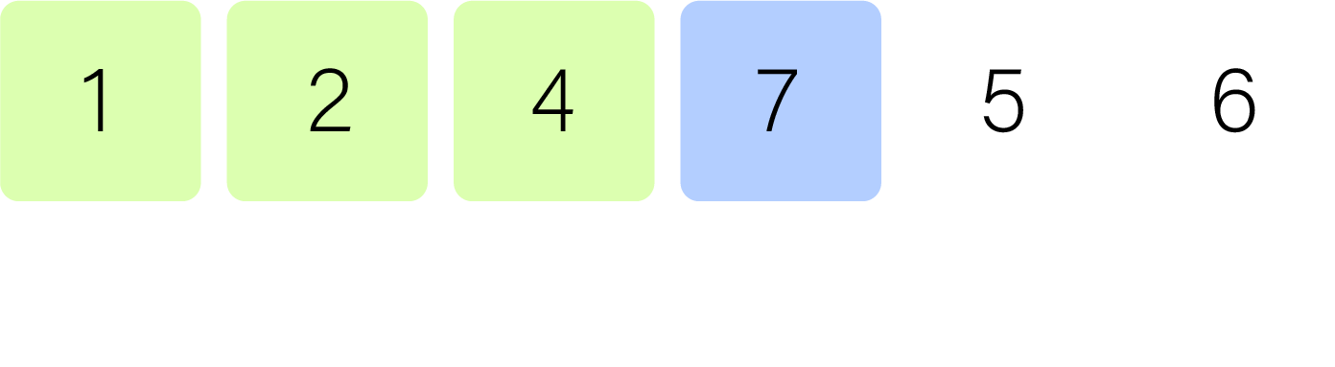
selection sort
Selection Sort Algorithm
hconyejelem@uh.edu
casauce3@cougarnet.uh.edu

Slide 60
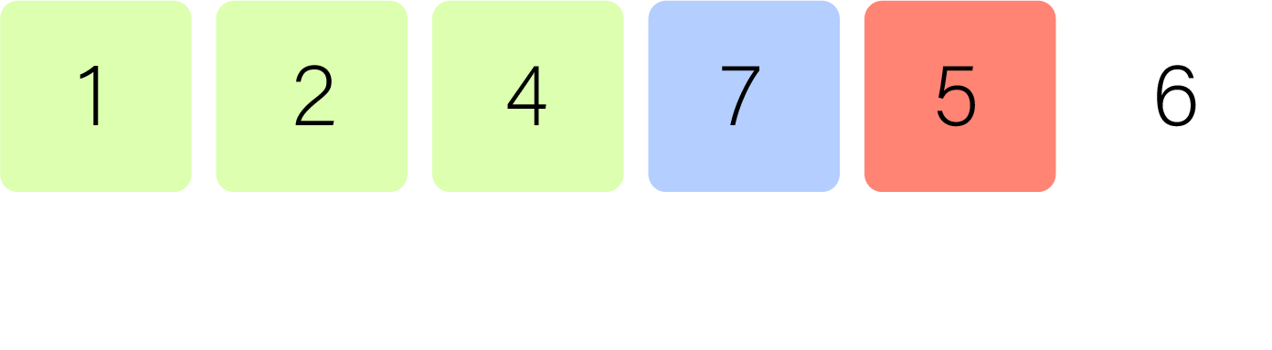
selection sort
Selection Sort Algorithm
hconyejelem@uh.edu
casauce3@cougarnet.uh.edu

Slide 61
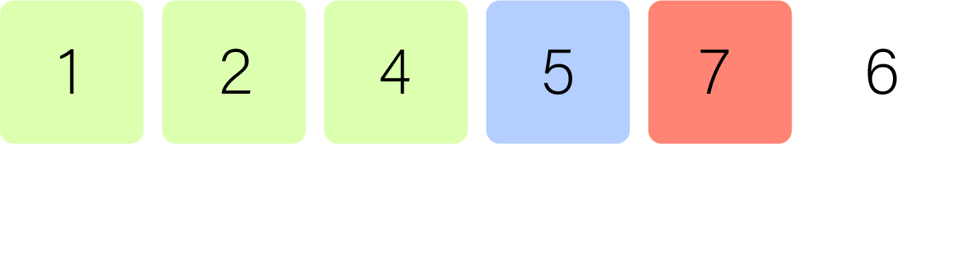
selection sort
Selection Sort Algorithm
hconyejelem@uh.edu
casauce3@cougarnet.uh.edu

Slide 62
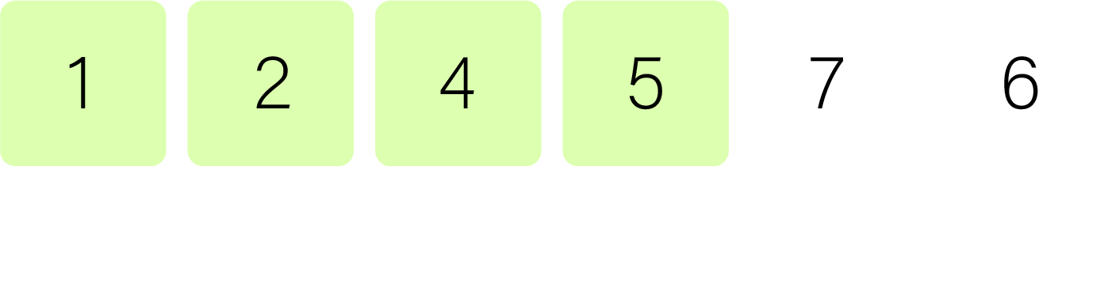
selection sort
Selection Sort Algorithm
hconyejelem@uh.edu
casauce3@cougarnet.uh.edu

Slide 63
selection sort
Selection Sort Algorithm
hconyejelem@uh.edu
casauce3@cougarnet.uh.edu

Slide 64
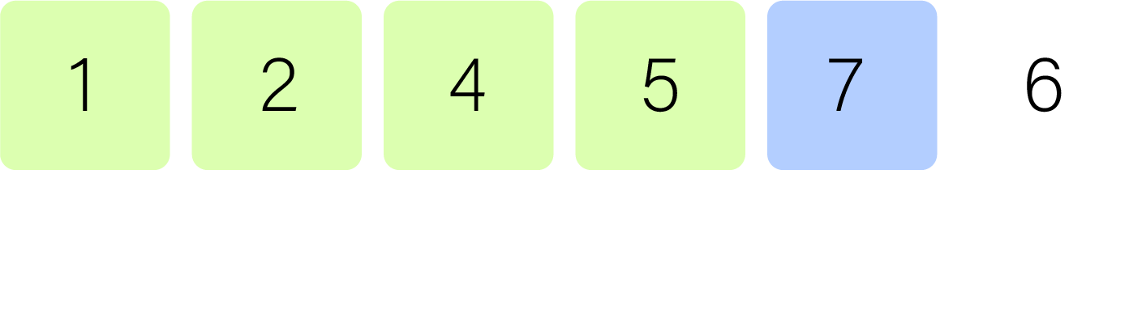
selection sort
Selection Sort Algorithm
hconyejelem@uh.edu
casauce3@cougarnet.uh.edu

Slide 65
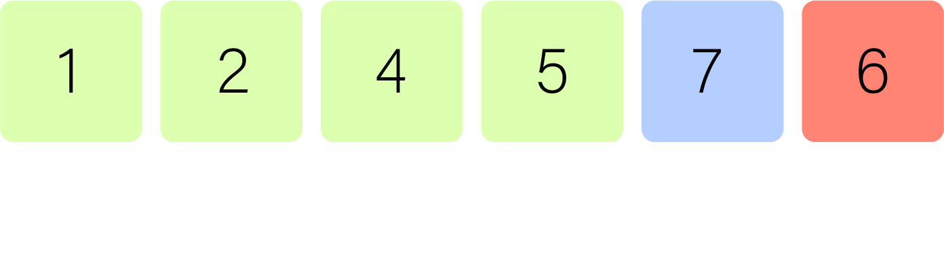
selection sort
Selection Sort Algorithm
hconyejelem@uh.edu
casauce3@cougarnet.uh.edu

Slide 66
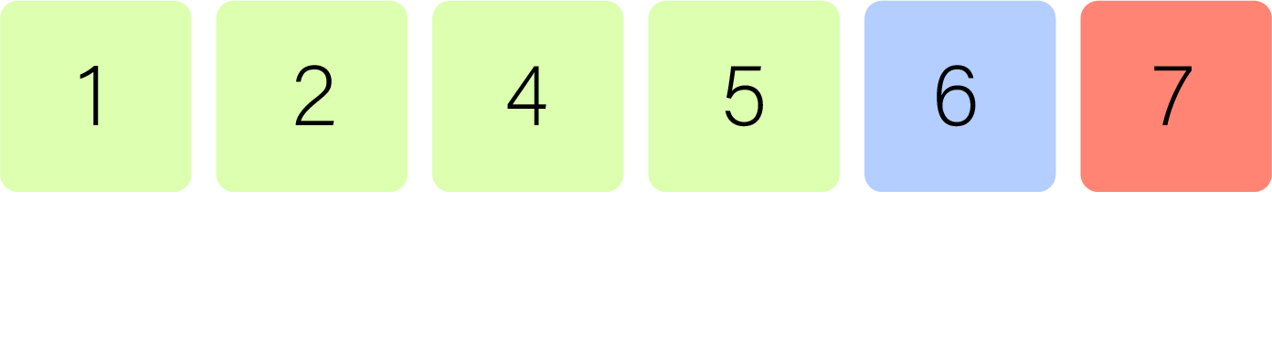
selection sort
Selection Sort Algorithm
hconyejelem@uh.edu
casauce3@cougarnet.uh.edu

Slide 67
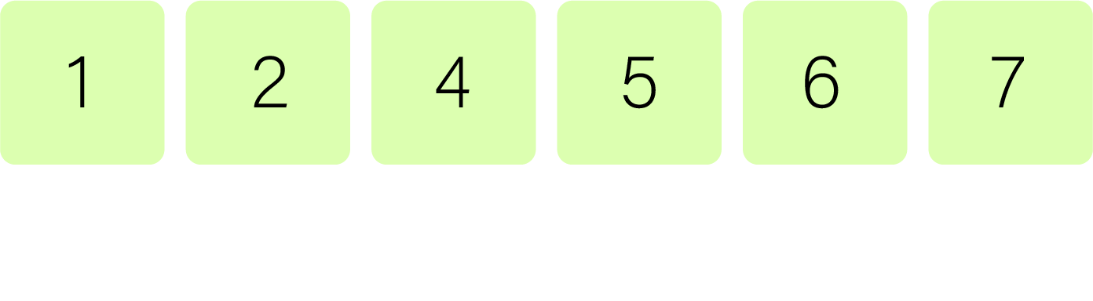
selection sort
Selection Sort Algorithm
hconyejelem@uh.edu
casauce3@cougarnet.uh.edu

Slide 68
selection sort
Code:
void selectionSort(int arr[], int n)
{
int i, j, min_idx;
for (i = 0; i < n - 1; i++) {
min_idx = i;
for (j = i + 1; j < n; j++) {
if (arr[j] < arr[min_idx])
min_idx = j;
}
if (min_idx != i)
swap(arr[min_idx], arr[i]);
}
}
hconyejelem@uh.edu
casauce3@cougarnet.uh.edu

Slide 69
selection sort
Time Complexity:
Selection Sort's simplicity comes at a cost in terms of time complexity. It exhibits a consistent time complexity of O(n^2), where 'n' represents the number of elements in the array. In both best-case and worst-case scenarios, the number of comparisons and swaps remains proportional to the square of the input size. This makes Selection Sort less efficient than many other sorting algorithms, especially for larger datasets.
However, Selection Sort's strength lies in its simplicity and its low number of swaps compared to other quadratic time complexity algorithms like Bubble Sort.
hconyejelem@uh.edu
casauce3@cougarnet.uh.edu

Slide 70
Insertion Sort
In the vast landscape of sorting algorithms, one stands out for its simplicity and effectiveness in certain scenarios: Insertion Sort. It is a fundamental sorting algorithm that finds practical use in various situations.
Insertion Sort is a straightforward sorting algorithm that builds the final sorted array one item at a time. It is aptly named because it inserts each element into its correct position within the sorted part of the array. The algorithm maintains two sub-arrays within the main array: one for the sorted elements and another for the unsorted elements. It repeatedly takes an element from the unsorted sub-array and places it into the correct position in the sorted sub-array, thus gradually extending the sorted portion.
hconyejelem@uh.edu
casauce3@cougarnet.uh.edu

Slide 71
insertion sort
Algorithmic Approach
Here's a breakdown of the algorithm's core steps:
Start with the second element (index 1) of the array; this element is considered "unsorted."
Compare the unsorted element with the elements in the sorted sub-array, shifting larger elements to the right until the correct position is found.
Insert the unsorted element into its correct position in the sorted sub-array.
Move to the next unsorted element (incrementing the index), and repeat steps 2 and 3 until the entire array is sorted.
The algorithm finishes when all elements are part of the sorted sub-array.
hconyejelem@uh.edu
casauce3@cougarnet.uh.edu

Slide 72
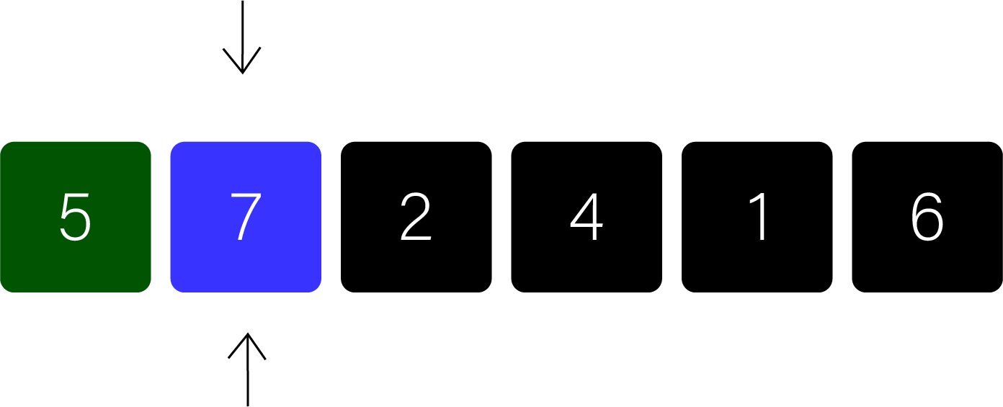
insertion sort
Insertion Sort Algorithm
hconyejelem@uh.edu
casauce3@cougarnet.uh.edu

Slide 73
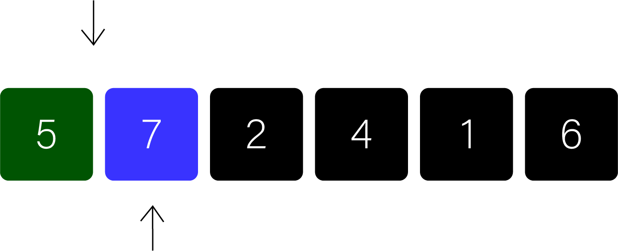
insertion sort
Insertion Sort Algorithm
hconyejelem@uh.edu
casauce3@cougarnet.uh.edu

Slide 74
insertion sort
Insertion Sort Algorithm
hconyejelem@uh.edu
casauce3@cougarnet.uh.edu

Slide 75
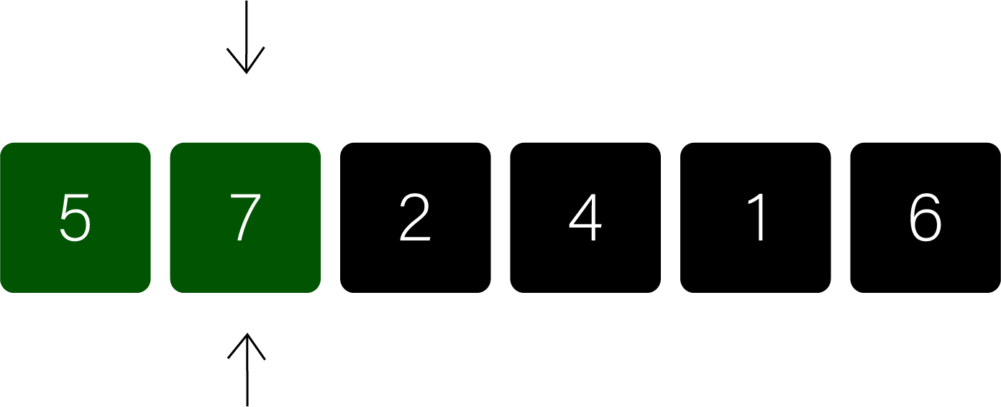
insertion sort
Insertion Sort Algorithm
hconyejelem@uh.edu
casauce3@cougarnet.uh.edu

Slide 76
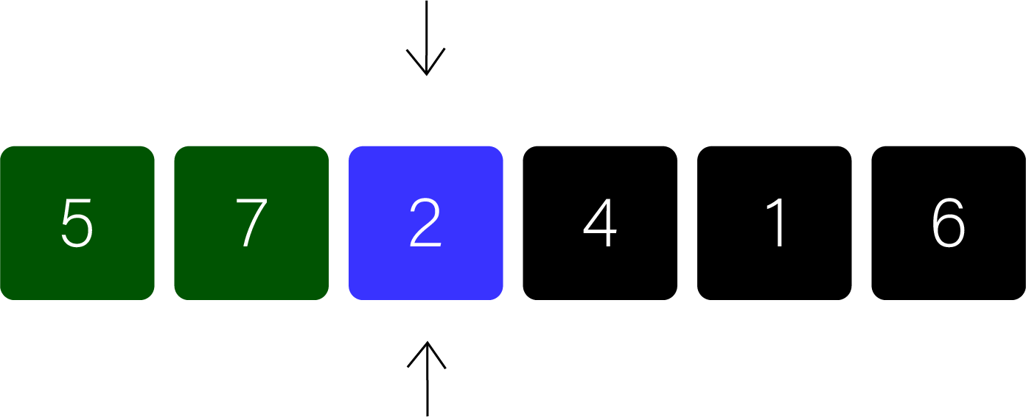
insertion sort
Insertion Sort Algorithm
hconyejelem@uh.edu
casauce3@cougarnet.uh.edu

Slide 77
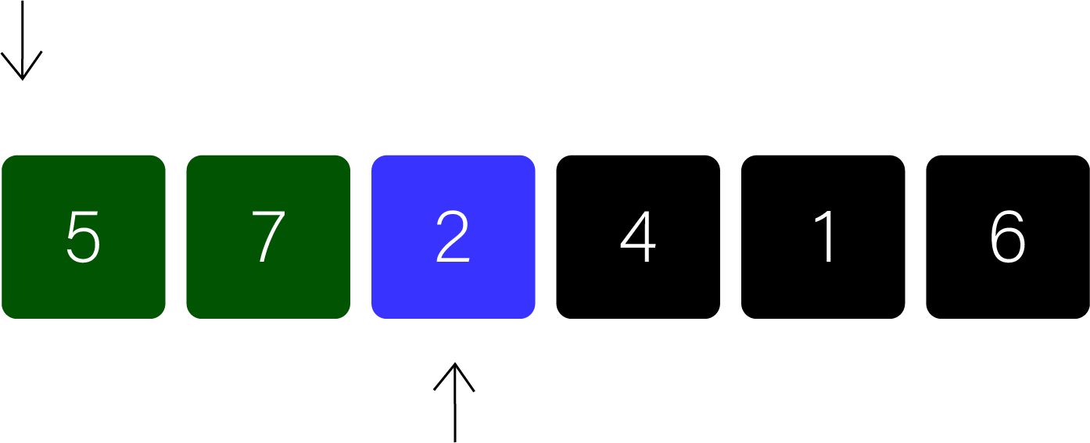
insertion sort
Insertion Sort Algorithm
hconyejelem@uh.edu
casauce3@cougarnet.uh.edu

Slide 78
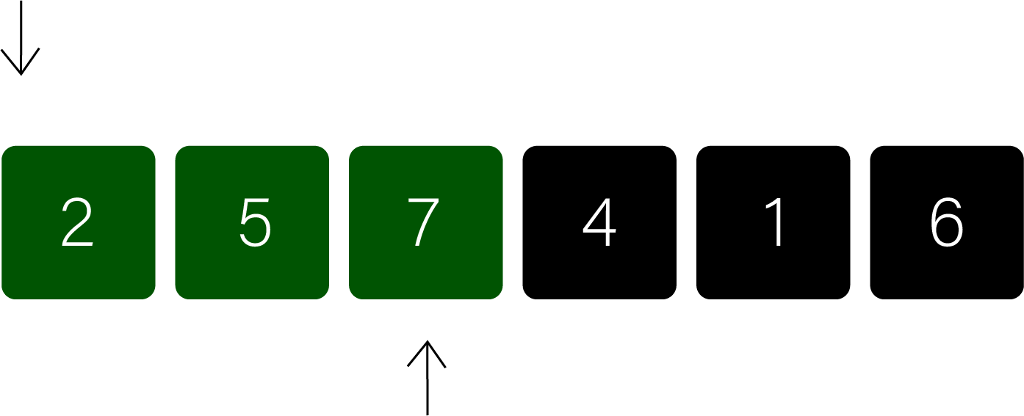
insertion sort
Insertion Sort Algorithm
hconyejelem@uh.edu
casauce3@cougarnet.uh.edu

Slide 79
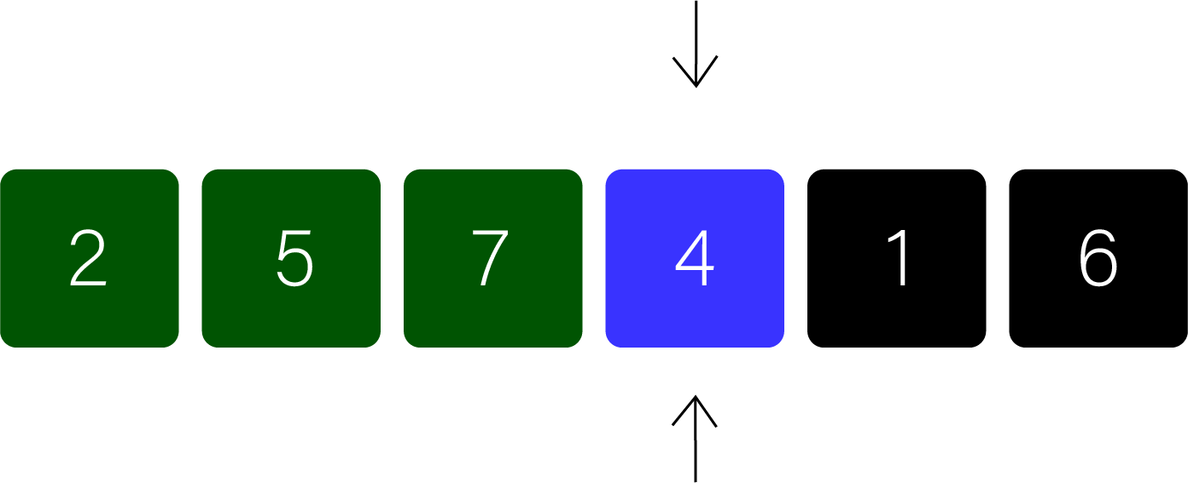
insertion sort
Insertion Sort Algorithm
hconyejelem@uh.edu
casauce3@cougarnet.uh.edu

Slide 80
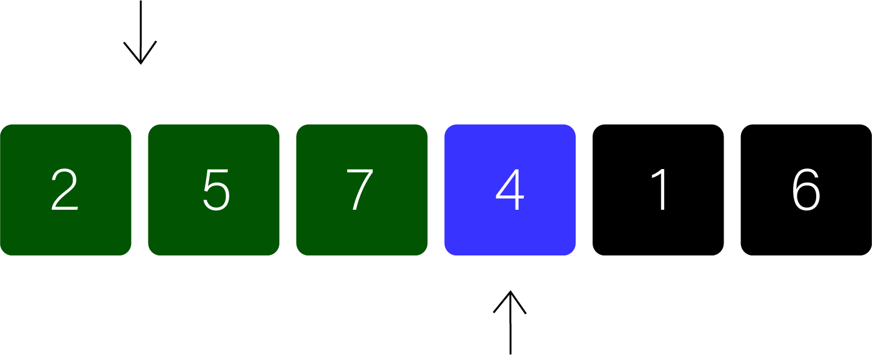
insertion sort
Insertion Sort Algorithm
hconyejelem@uh.edu
casauce3@cougarnet.uh.edu

Slide 81
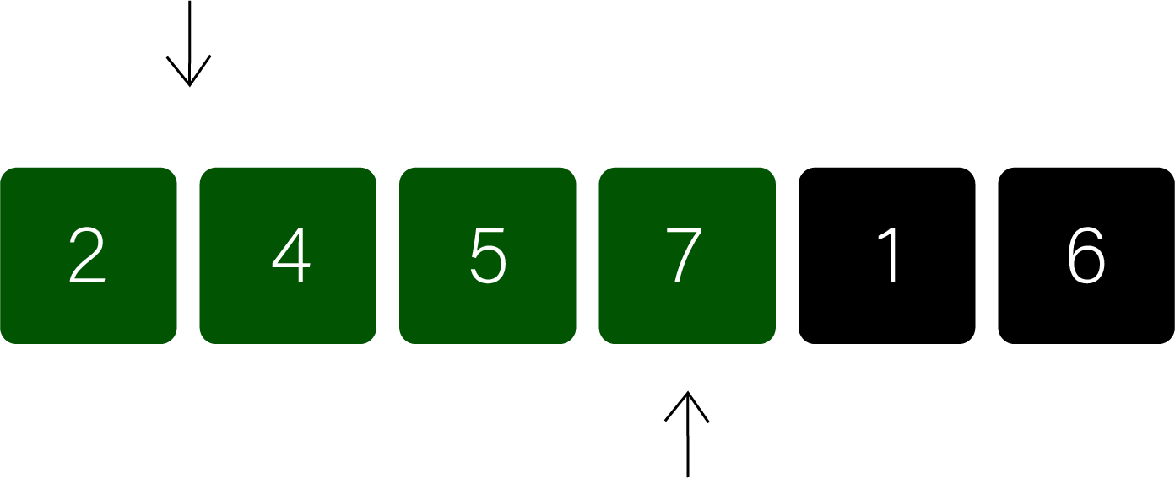
insertion sort
Insertion Sort Algorithm
hconyejelem@uh.edu
casauce3@cougarnet.uh.edu

Slide 82

insertion sort
Insertion Sort Algorithm
hconyejelem@uh.edu
casauce3@cougarnet.uh.edu

Slide 83
insertion sort
Insertion Sort Algorithm
hconyejelem@uh.edu
casauce3@cougarnet.uh.edu

Slide 84

insertion sort
Insertion Sort Algorithm
hconyejelem@uh.edu
casauce3@cougarnet.uh.edu

Slide 85

insertion sort
Insertion Sort Algorithm
hconyejelem@uh.edu
casauce3@cougarnet.uh.edu

Slide 86

insertion sort
Insertion Sort Algorithm
hconyejelem@uh.edu
casauce3@cougarnet.uh.edu

Slide 87

insertion sort
Insertion Sort Algorithm
hconyejelem@uh.edu
casauce3@cougarnet.uh.edu

Slide 88

insertion sort
Insertion Sort Algorithm
hconyejelem@uh.edu
casauce3@cougarnet.uh.edu

Slide 89
insertion sort
Code:
void insertionSort(int arr[], int n)
{
int i, key, j;
for (i = 1; i < n; i++) {
key = arr[i];
j = i - 1;
while (j >= 0 && arr[j] > key) {
arr[j + 1] = arr[j];
j = j - 1;
}
arr[j + 1] = key;
}
}
hconyejelem@uh.edu
casauce3@cougarnet.uh.edu

Slide 90
insertion sort
Time Complexity:
Insertion Sort's time complexity depends on the arrangement of elements in the input array. In the best-case scenario, where the array is already sorted, Insertion Sort exhibits a time complexity of O(n). Each element is compared to the elements in the sorted sub-array, but no swaps are needed because the elements are already in the correct order.
In the worst-case scenario, where the array is sorted in reverse order, the time complexity is O(n^2), making it less efficient than some other sorting algorithms for large datasets. However, for small datasets or nearly sorted arrays, Insertion Sort can outperform more complex algorithms.
hconyejelem@uh.edu
casauce3@cougarnet.uh.edu

